Slide 1
Parent Guide

Slide 2
What Is Schoology?
Teachers use Schoology to post their classroom materials online, provide a safe forum for students to discuss their ideas and collaborate on projects, and to assign and collect homework digitally. It helps students stay organized and it keeps the class connected.

Slide 3
Schoology: Parent Account
A Schoology Parent Account gives you access to:
The classes your child is enrolled in
Your child’s upcoming assignments
School and class announcements
Schoology makes it easy for parents to stay involved in their children’s education.

Slide 4
Setting Up Your Account
Having a Parent account in Schoology is actually like having two accounts:
Your personal account, with your own name and information.
Your Child Activity view. From here, you can view Schoology from your child’s perspective, and see what he or she sees, and receive updates about his or her activity.
The first time you log into Schoology, you may want to set up some of your account settings to make sure you get the most out of Schoology.
Continued on next slide

Slide 5
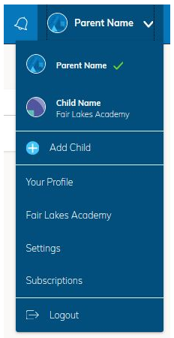
Setting Up Your Account
Start by clicking on the arrow in the upper-right corner (next to your name) and then select your child’s name to switch into his or her account. The check mark in this drop-down menu indicates which account you are currently in.

Slide 6
Notifications
To set up your notifications: Click Settings from the drop-down menu in the upper right hand corner. From the account settings area, click into the Notifications tab.
Follow these steps in your own account to configure your own settings.
Follow these steps in your child view to control how Schoology contacts you about your child’s school activities.

Slide 7
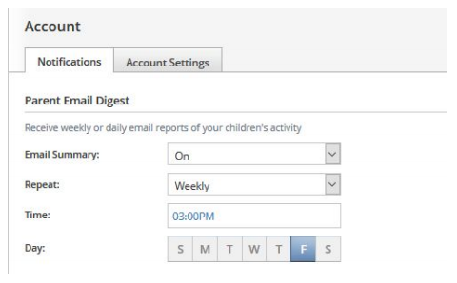
Setting Up Your Parent Email Digest
The Schoology Parent Email Digest is a brief summary of your child’s activities delivered right to your inbox. Here, you can opt to receive it on a daily or weekly basis.
Continued on next slide

Slide 8
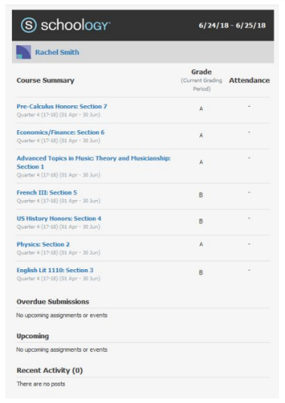
Setting Up Your Parent Email Digest
A Parent Email Digest contains information such as courses your child is enrolled in and grade and attendance information, as well as overdue and upcoming assignments.
Depending on the settings configured by your child’s teachers and school administrators, an example of a Parent Email Digest might look like this:

Slide 9
Overdue Submissions Email
In addition to the Parent Email Digest email, you can opt to receive additional email notifications when your child has an overdue assignment:
Once you have configured your Parent Email Digest and Overdue Submissions Email settings, click Save Changes.

Slide 10
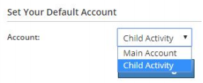
Account Settings
The Account Settings page is where you can do things like change your password or update your email address. You can also determine your landing page when you login to Schoology.
To go to the Account Settings page, click the arrow in the upper-right corner and select Settings from the menu. Scroll down to Set Your Default Account.
Continued on next slide

Slide 11
Account Settings
This determines the first page you see when you log in to your Schoology account. You can toggle into your child’s account at any time, to stay updated on his or her schoolwork and activity.
From the Default Account menu:
Select Main Account if you would like to see your own personal account when you log in.
Select Child’s Activity if you want to automatically start in your child’s account when you log in.

Slide 12
Navigating Schoology
Your Account
After logging in, you can see the top navigation bar from anywhere in Schoology. From this navigation bar, you can navigate to the three main areas of Schoology: Courses, Groups, and Resources. You can return home at any time by clicking Schoology in the left corner.
Continued on next slide

Slide 13
Navigating Schoology
Messages & Notifications
When you are in your own Schoology account (not your child’s), icons for your own calendar, messages, connections and notifications are displayed in the top navigation bar, on the right. Any time someone sends you a message, or does something that pertains to you or your child’s school, it’s easily accessible in the top-right corner of your screen. Everything is chronologically ordered and clickable to make managing them simple. You can also click the arrow to the right of your name to view your own user profile.
Continued on next slide

Slide 14
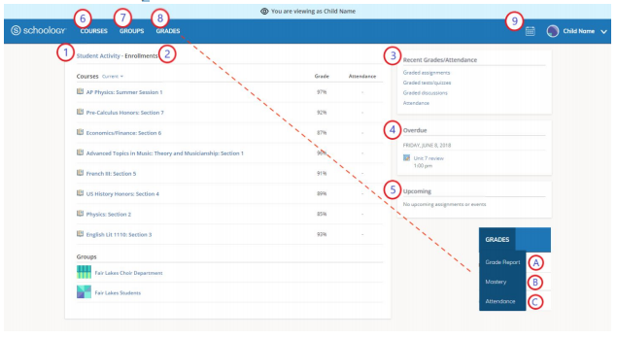
Navigating Schoology
Viewing Your Child’s Activity
Click on the arrow in the upper-right corner of your account and select your child’s name to view his or her activity.
Continued on next slide

Slide 15
Navigating Schoology
From the home page, you can quickly view specific information about your child’s Schoology activity:
The Student Activity area in the center of the page displays your child’s recent submission, grade, and attendance information.
Toggle into Enrollments in the same area to see a list of the courses your child is currently enrolled in, along with his or her grade. If the teacher or administrator has chosen not to display the grade while the course is in progress, you will see a blank value (as in the grade column on the previous slide). Click on an individual course to see grades received on assignments, tests, and discussions from that course.
The Recent Grades/Attendance area lists graded assignments, tests/quizzes, discussions, and attendance marks for the student. To view the graded items and attendance marks, click the item you'd like to view.

Slide 16
Navigating Schoology
From the home page, you can quickly view specific information about your child’s Schoology activity:
4. The Overdue section displays a list of course materials your child did not turn in by the due date.
5. The Upcoming section displays a list of your child’s upcoming assignments and events.
6. Courses: You can see a list of your child’s current courses. Click the course name to navigate to the course profile as your child views it.
7. Groups: You can see a list of your child’s Schoology Groups. Groups can be used for a variety of activities, from school projects to extracurricular teams and clubs.

Slide 17
Navigating Schoology
From the home page, you can quickly view specific information about your child’s Schoology activity:
8. Grades: Depending on the settings in place at your child’s school, this menu provides access to view the following:
Grade Report: Review your child’s grades for all courses.
Mastery: If your child’s school aligns materials to standard and learning objectives, you can check your child’s progress in this area.
Attendance: Review your child’s attendance for all courses.

Slide 18
Navigating Schoology
From the home page, you can quickly view specific information about your child’s Schoology activity:
9. Calendar: Click to view a calendar of past and upcoming events and assignments. To find out more information regarding a particular event, place your cursor over the title. A clue tip displays with the event type (assignment, test/quiz, event), the event's course or group, and the student name. Click the event to display profile information in a pop-up window.
Note: There is no Messages icon in the Child Activity view. Messages to your child are private and are not viewable from a parent account.

