Slide 1
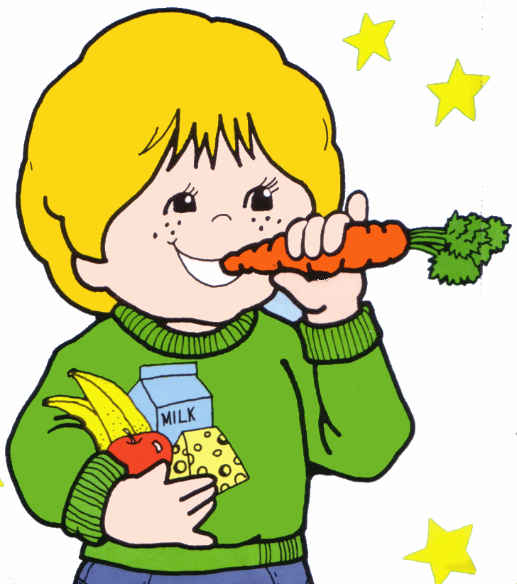
Snack Rules!
Created and presented by:
Doaa, Asiya, Sabreen,
Hussein and Radwan

Slide 2
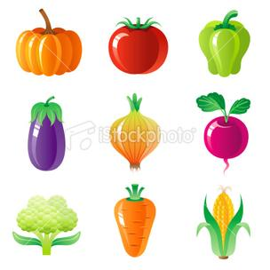
Do bring healthy snacks, like fruits and vegetables.

Slide 3
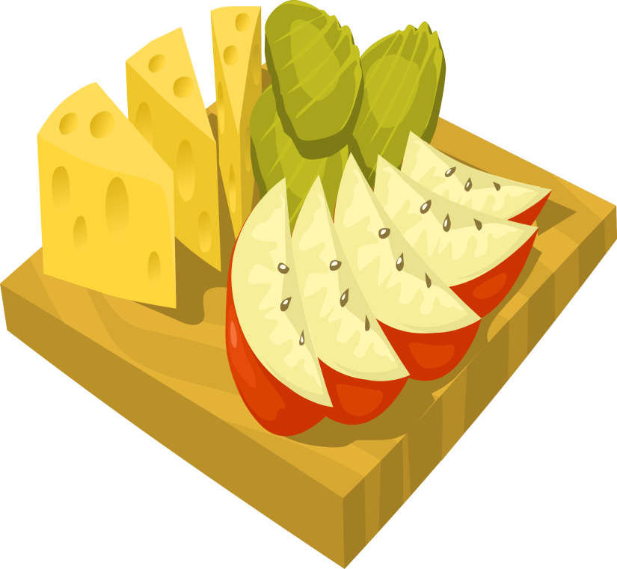
Do bring a small snack that you can eat quickly.

Slide 4
Do clean up after yourself.

Slide 5
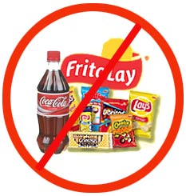
Don’t bring unhealthy snacks, like chips, cookies and candy!

Slide 6
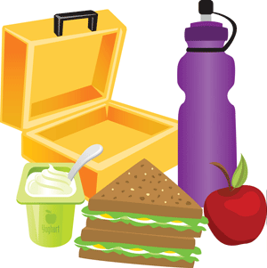
Don’t bring a big snack that you will not have time to eat.

Slide 7
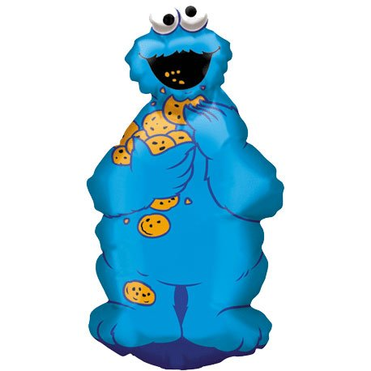
Don’t make a mess.

Slide 8
Thank you!
Stay Healthy!

