Slide 1
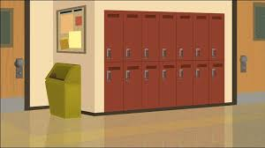
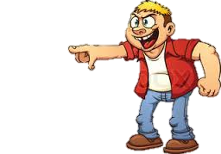
Just Leave The kid Alone
No you little punk…...you forgot to do my homework.
Ah Ah….
Can you just leave me alone.

Slide 2
Just Leave The kid Alone
Now you get What you deserve!
Please just leave me alone…

Slide 3
Just Leave The Kid Alone
Just let me go…
No!

Slide 4
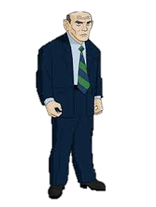
Just Leave The Kid Alone
Now let the kid go!
Ill do your homework tomorrow just let me go your hurting me.
I said No!

Slide 5
Just Leave The Kid Alone
“Oh it’s the principle”…..
Now!

Slide 6
Fine ill let him go but I'm still going to make fun of him….
Just Leave The Kid Alone
I said now…

Slide 7
Just Leave The Kid Alone
Ha-ha loser…
Let’s go into my office…

Slide 8
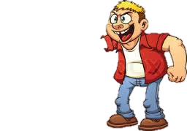
I'm leaving I have better things to do!
Just Leave The Kid Alone
Your welcome
Thank you.

Slide 10
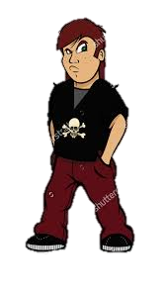
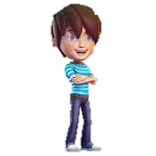
Be A Up stander
You such a loser I told you to give me your lunch money!
But but..

Slide 11
Be A Up stander
I don’t care!
I need my lunch money.

Slide 12
Be A Up stander
I already told you want I want !
I want to leave.

Slide 13
Be A Up stander
Come back here your not leaving until I get the money.

Slide 14
Be A Up stander
Now

Slide 15
Be A Up stander
That punk better not leave.
What is all the noise.

Slide 16
Be A Up stander
Who do you think you are you little bug.
I’m waiting for a response.

Slide 17
Be A Up stander
I’m the person waiting for you to let the kid go..
Well I’m not

Slide 18
Be A Up stander
Ok I guess he can go you better have lunch money.
Kid you can go.
Thank you.

Slide 19
Be A Up stander
Fine bug ill let you go.
Well I don’t but I will tell the principle.

Slide 20
Be A Up stander
……..
I guess this is goodbye

Slide 21
Be A Up stander
……..

Slide 23
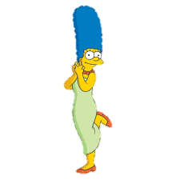
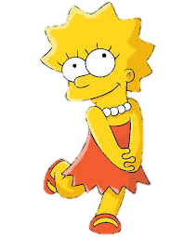
You can Stand Up for Yourself
Aw my baby’s first day of fifth grade school.
I know mom I’m excited.

Slide 24
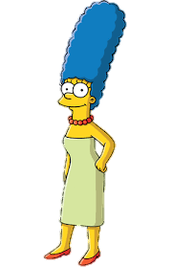
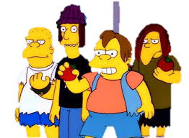
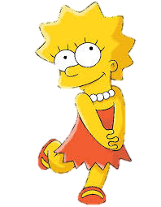
You Can Stand Up For Yourself
Ok well, I have to get going, have a good day.
Ok mom bye.

Slide 25
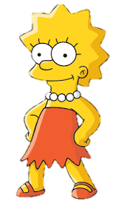
You can Stand Up for Yourself
Aw the little baby saying bye to her mami.
Leave me alone

Slide 26
You can Stand Up for Yourself
Your so stupid how did you even get to fifth grade.
Look who is talking your like 20 and in fifth grade.

Slide 27
You can Stand Up for Yourself
Your such a loser
Ok whatever

Slide 28
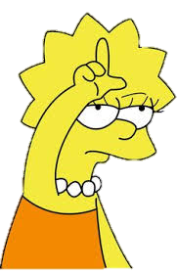
You can Stand Up for Yourself
Whatever kid were leaving.
Look who’s the loser I’m going to get smart and you stay stupid.

Slide 29
You can Stand Up for Yourself

