Slide 1
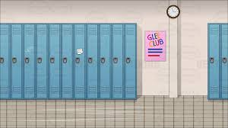
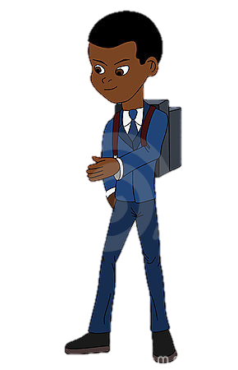
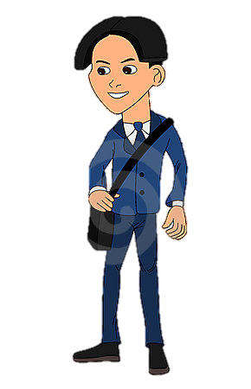
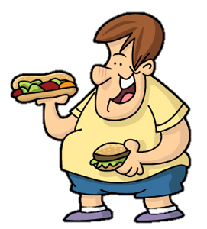
Tell A Bully To Stop By: Salah Murshed
STOP

Slide 2
Tell A Bully To Stop
Younis your so fat.

Slide 3
Tell A Bully To Stop
What's wrong with eating I am hungry.
Younis your so fat

Slide 4
Tell A Bully To Stop
Your always eating.

Slide 5
Tell A Bully To Stop
Why do you care if I eat ? you want some.

Slide 6
Tell A Bully To Stop
Save some for us.

Slide 7
Tell A Bully To Stop
Affef why do you always bully kids?

Slide 8
Tell A Bully To Stop
STOP BULLYING YOUNIS.

Slide 9
Tell A Bully To Stop
STOP OR I WILL TELL Mr. Jaber.

Slide 10
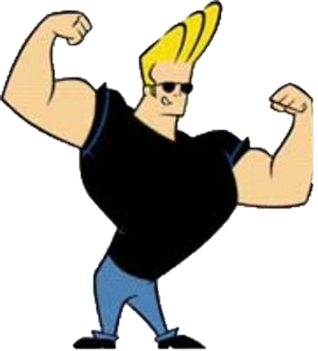
Tell A Bully To Stop
What's going on kids?

Slide 11
Tell A Bully To Stop
Affef is bullying Younis.

Slide 12
Tell A Bully To Stop
Affef in my office.

Slide 13
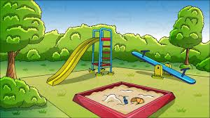
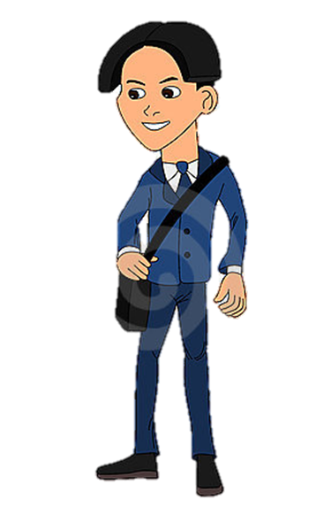
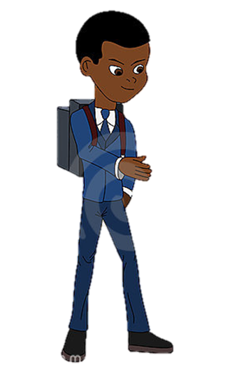
Walk Away From A Fight
Salah, Why did you snitch ?

Slide 14
Walk Away From A Fight
I had to, Affef.

Slide 15
Walk Away From A Fight
Wanna fight ? I will beat you up.

Slide 16
Walk Away From A Fight

Slide 17
Walk Away From A Fight

Slide 18
Walk Away From A Fight

Slide 19
Walk Away From A Fight

Slide 20
Walk Away From A Fight

Slide 21
Walk Away From A Fight

Slide 22
Walk Away From A Fight

Slide 23
Walk Away From A Fight

Slide 24
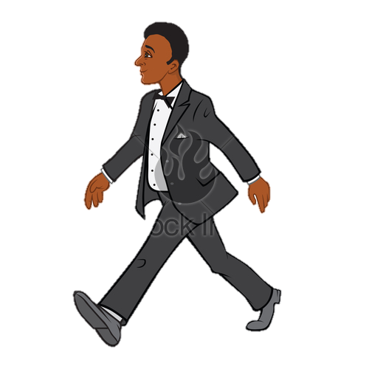
Never Keep It A Secret

Slide 25
Never Keep It A Secret
Dad, Affef is bullying me and Younis in school.

Slide 26
Never Keep It A Secret
I will go to Younis’s dad and tell him about it.

Slide 27
Never Keep It A Secret
OK dad

Slide 28
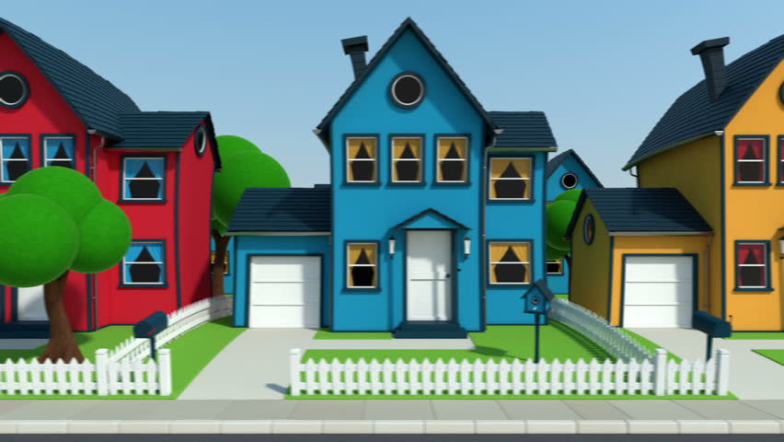
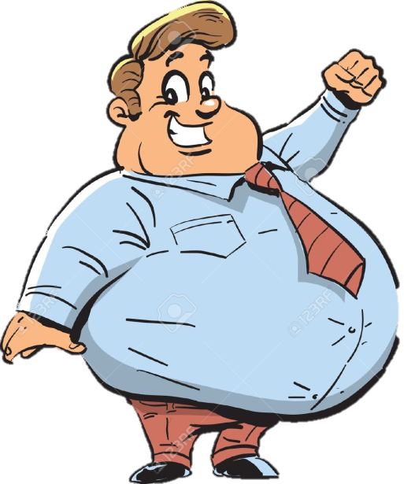
Never Keep It A Secret
Hi, Nasser

Slide 29
Never Keep It A Secret
Hi

Slide 30
Never Keep It A Secret
Your son and my son are getting bullied in school want to go tell the principle.

Slide 31
Never Keep It A Secret
Sure

Slide 32
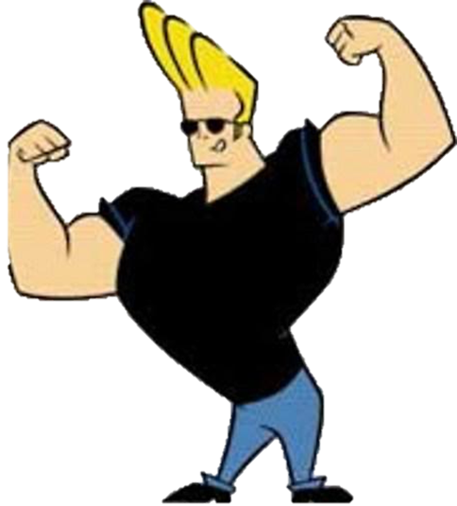
Never Keep It A Secret
Hi, Mr. Jaber

Slide 33
Never Keep It A Secret
Hi

Slide 34
Never Keep It A Secret
Your student Affef is bullying my son Salah.

Slide 35
Never Keep It A Secret
And my son Younis.

Slide 36
Never Keep It A Secret
I am going to suspend him and talk to his dad.

Slide 37
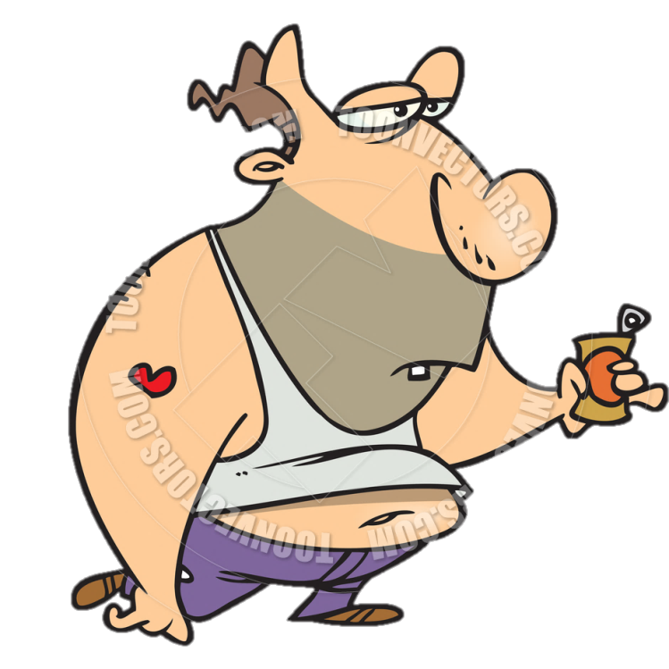
Never Keep It A Secret
Hello, Sufyan

Slide 38
Never Keep It A Secret
Hello, Mr. Jaber

Slide 39
Never Keep It A Secret
Your son Affef keeps on bullying kids. And I have to suspend him for 5 days.

