Slide 1
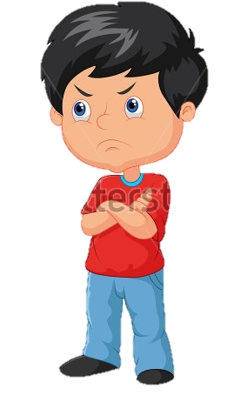
Be the bigger person
The weather is beautiful but I cant get that bully off my mind.

Slide 2
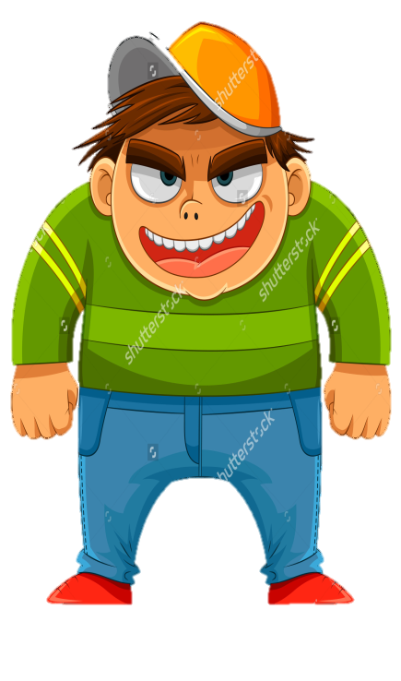
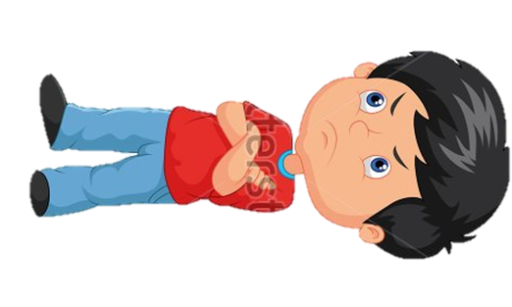
Be the bigger person.
What is he doing here .

Slide 3
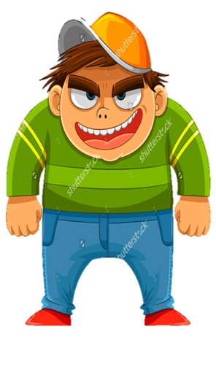
Be the bigger person.
Come fight me you ugly kid

Slide 4
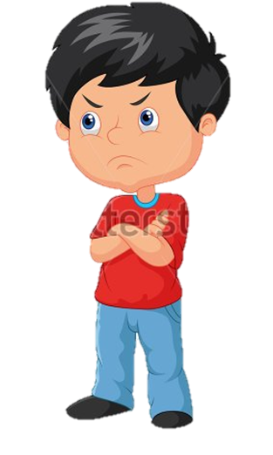
Be the bigger person.
Just leave me alone.

Slide 5
Be the bigger person.
No I will not leave you alone.

Slide 6
Be the bigger person.
Then I will just leave.

Slide 7
Be the bigger person.
Such a baby.

Slide 8
Be the bigger person.
Such a baby.

Slide 9
Be the bigger person.
Such a baby.

Slide 11
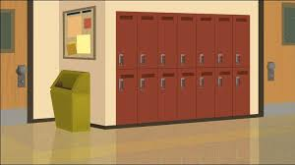
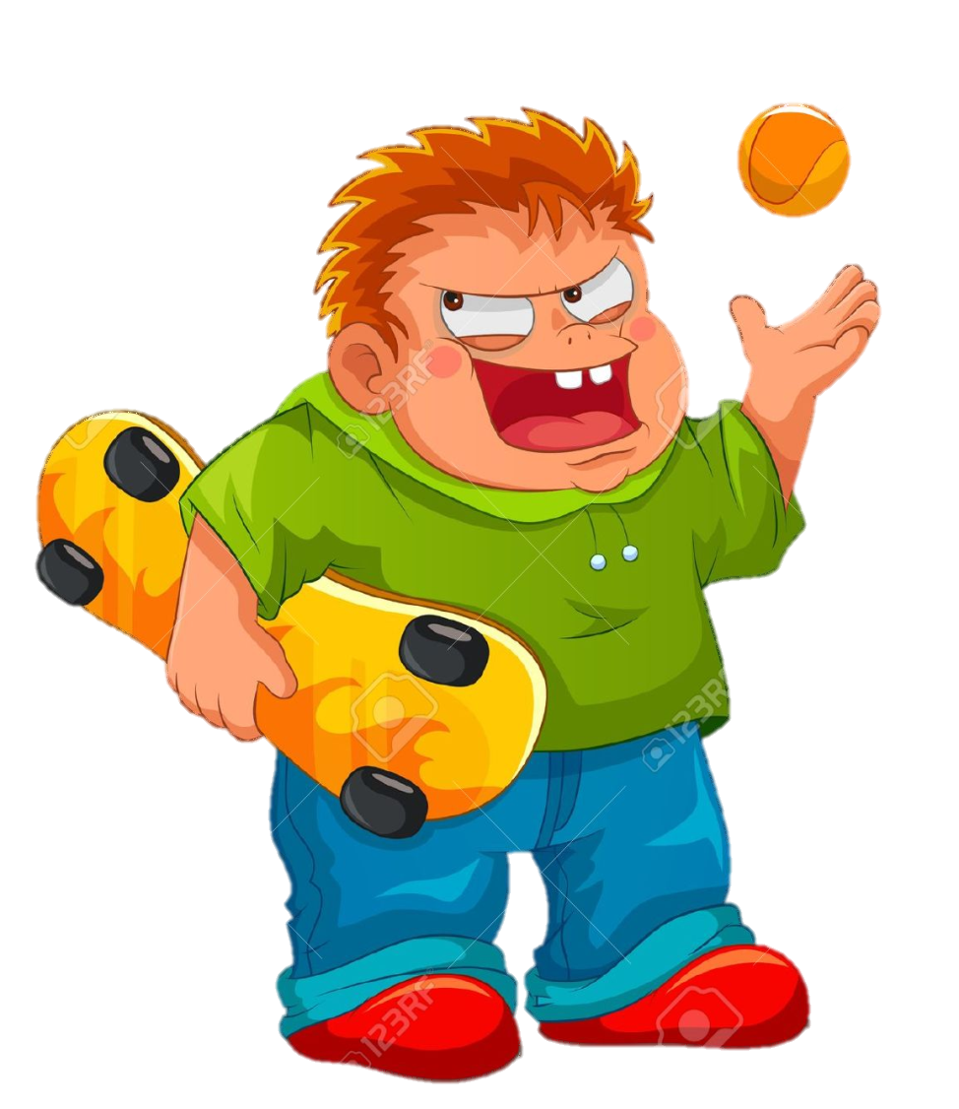
Don’t keep it a secret.
Haven't you done enough John.

Slide 12
Don’t keep it a secret.
I'm not done yet josh.

Slide 13
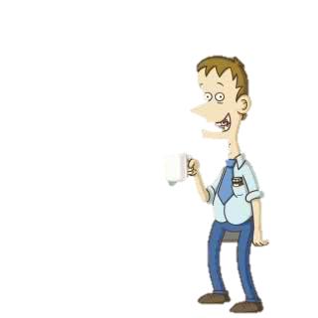
Don’t keep it a secret.
You boys good here.

Slide 14
Don’t keep it a secret.
Yes were fine.

Slide 15
Don’t keep it a secret.
How about you josh are you fine.

Slide 16
Don’t keep it a secret.
Yes principle Harmsworth we are fine.

Slide 17
Don’t keep it a secret.
What happened to you josh.

Slide 18
Don’t keep it a secret.
Oh I fell at home.

Slide 19
Don’t keep it a secret.
Oh ok bye.

Slide 20
Don’t keep it a secret.

Slide 21
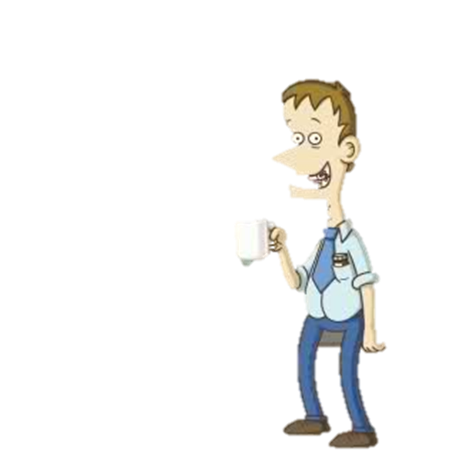
Don’t keep it a secret.

Slide 22
Don’t keep it a secret.

Slide 23
Don’t keep it a secret.
Your lucky you kept your mouth shut.

Slide 25
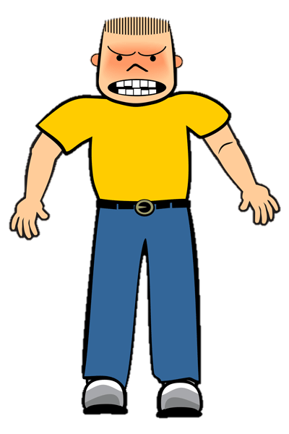
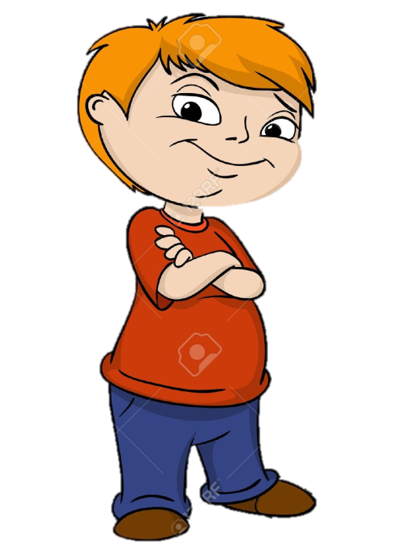
Be an up stander
Give me your money and your shoes.

Slide 26
Be an up stander
Leave me alone I got these shoes today.

Slide 27
Be an up stander
Give me the stuff or you'll get it.

Slide 28
Be an up stander
Hey leave him alone.

Slide 29
Be an up stander
Your lucky.

Slide 30
Be an up stander
Thank you.

Slide 31
Be an up stander
No problem.

Slide 32
Be an up stander
bye

Slide 33
Be an up stander
bye

Slide 34
Be an up stander

Slide 35
Be an up stander

Slide 36
Be an up stander
That bully was a jerk.

