Slide 1
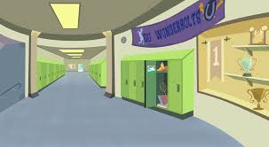
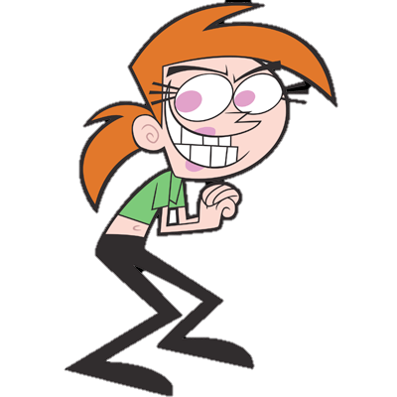
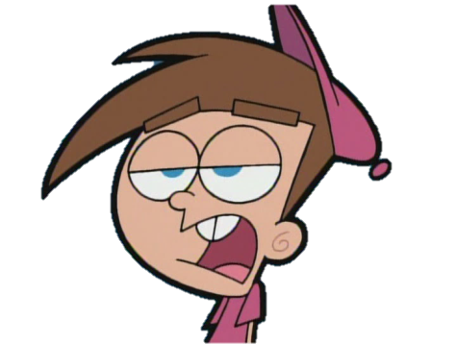
Don’t Be a Bystander, Be an Up stander
Oh just shut up and give my your lunch money!
Please leave me alone you’re gonna draw a crowd

Slide 2
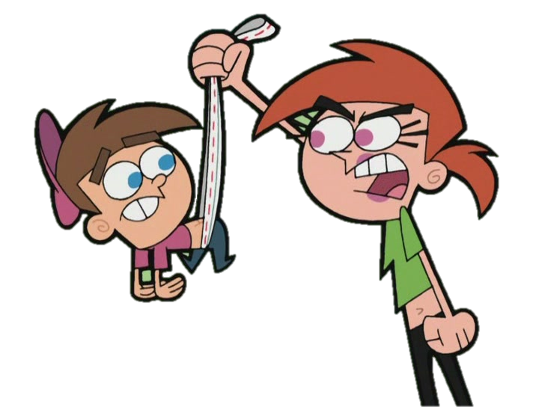
Fight!
Fight!
Fight!

Slide 3
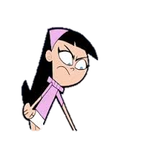
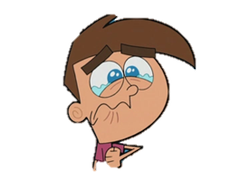
Hey! Leave him alone!

Slide 4
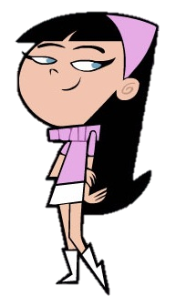
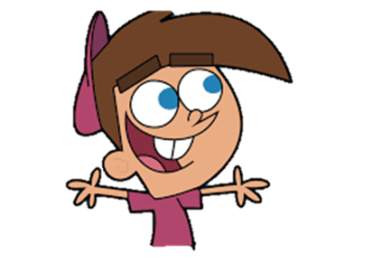
No problem, people can be jerks sometimes
Hey, thanks for helping me

Slide 5
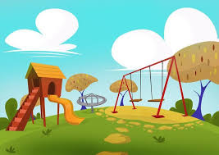
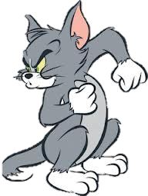
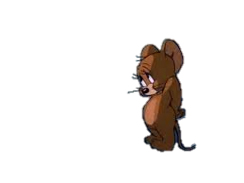
Stop a bully
Hey Jerry why didn’t you give me your turn on the slide!
Because I wanted a turn

Slide 6
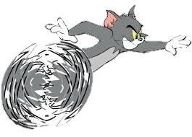
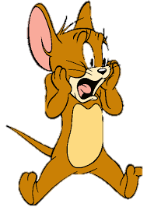
Stop a bully
Now I’m mad. I’ m gonna get you!

Slide 7
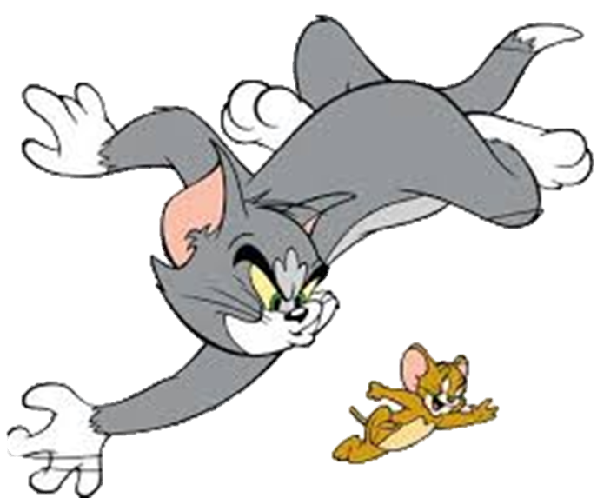
Stop a bully
Ahhh! Stop!

Slide 8
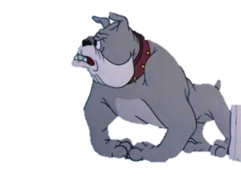
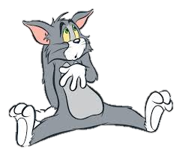
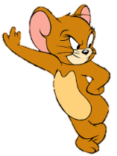
Stop a bully
Ay! leave him alone!
Yeah Tom

Slide 10
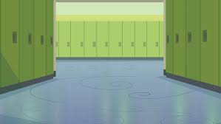
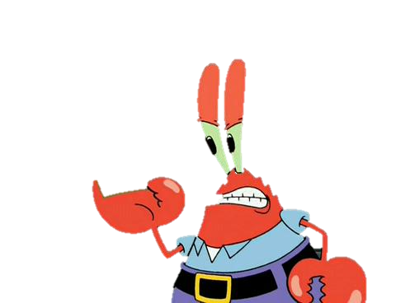
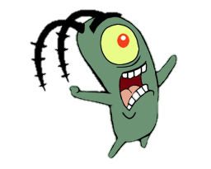
Walk away from a fight
Ay! Plankton why did you eat my slice of pizza!
Sorry I was extra hungry

Slide 11
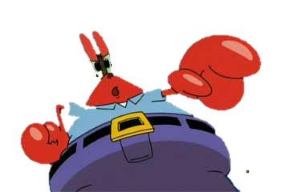
Walk away from a fight
Well that’s not okay!
I said I was sorry

Slide 12
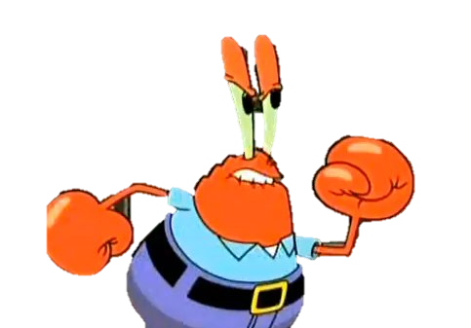
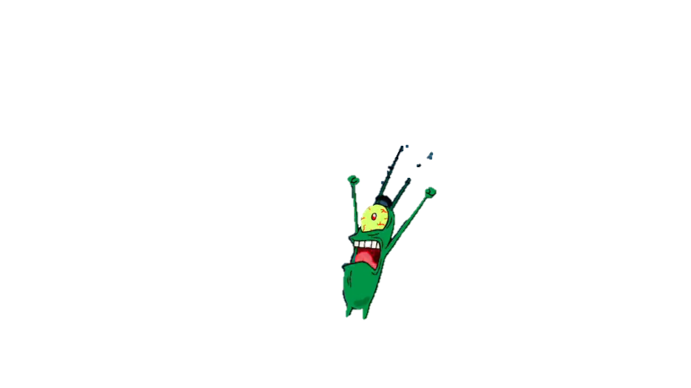
Walk away from a fight
Well now you’re gonna get it!
Ay Krab’s I’m not trying to start a fight

Slide 13
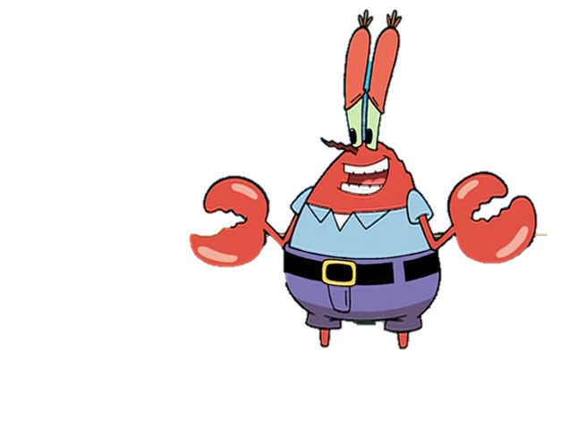
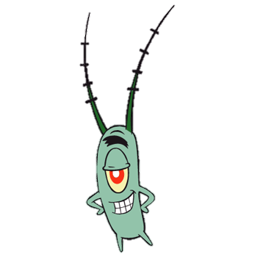
Walk away from a fight
Oh well I’m sorry I’m just stressed so I took it out on you
That’s alright

