Slide 1
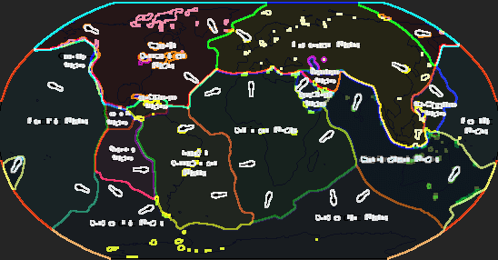
Tectonic Plates
Haneen Ghafoor
5th hour
12-9-16

Slide 2
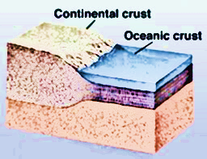
Oceanic V.S Continental Crust
Oceanic Crust
Continental Crust
It is composed of several layers, not including the overlying sediment.
Oceanic crust is about 6 km (4 miles) thick.
The oceanic crust includes lavas made of basalt that is, rock material consisting largely of plagioclase feldspar and pyroxene
continental crust is the layer of granitic, sedimentary and metamorphic rocks
Continental crust is about 35 to 40 km
the relatively thick part of the earth's crust that forms the large landmasses. It is generally older and more complex than the oceanic crust.

Slide 3
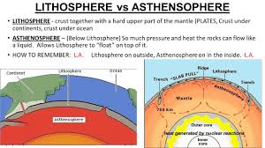
Lithosphere V.S Asthenosphere
Lithosphere
Asthenosphere
The rigid outer part of the earth, consisting of the crust and upper mantle.
The upper layer of the earth's mantle, below the lithosphere, in which there is relatively low resistance to plastic flow and convection is thought to occur.

Slide 4
Convergent And Divergent Boundaries
Convergent Boundary
Divergent Boundary
In plate tectonics, a convergent boundary, also known as a destructive plate boundary (because of subduction), is an actively deforming region where two (or more) tectonic plates or fragments of the lithosphere move toward one another and collide.
In plate tectonics, a divergent boundary or divergent plate boundary (also known as a constructive boundary or an extensional boundary) is a linear feature that exists between two tectonic plates that are moving away from each other.

Slide 5
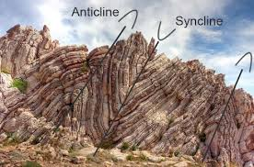
Folding V.S Faulting
Folding
Faulting
A bend in a layer of rock or in another planar feature such as foliation or the cleavage of a mineral. Folds occur as the result of deformation, usually associated with plate-tectonic forces.
In geology, a place where sections of the crust of the Earth move relative to each other. (See earthquake and San Andreas fault.) Note: Faults tend to occur near the edges of tectonic plates.

Slide 6
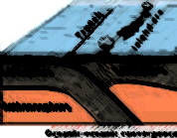
Oceanic Crust V.S Oceanic Lithosphere
Oceanic crust
Oceanic lithosphere
the relatively thin part of the earth's crust that underlies the ocean basins. It is geologically young compared with the continental crust and consists of basaltic rock overlain by sediments.
Earth's lithosphere includes the crust and the uppermost mantle, which constitute the hard and rigid outer layer of the Earth. The lithosphere is subdivided into tectonic plates.

Slide 7
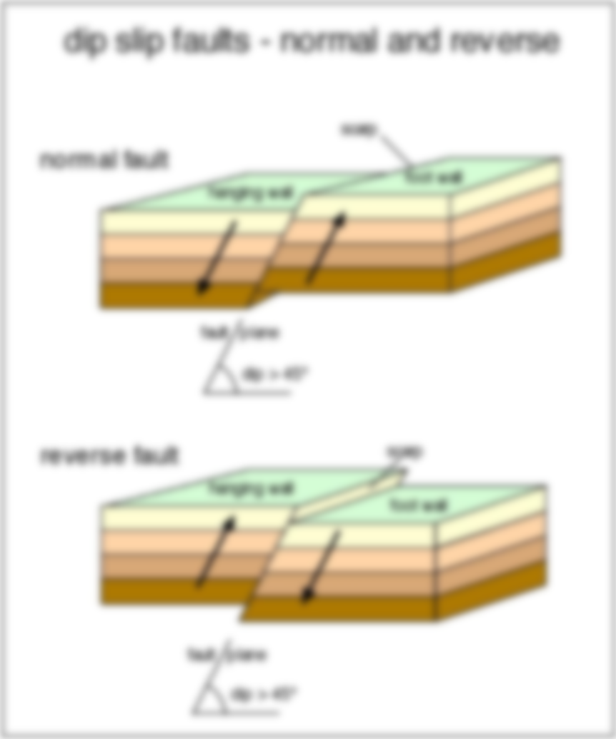
Normal fault V.S Reverse Fault
Normal Fault
Reverse Fault
normal fault. A geologic fault in which the hanging wall has moved downward relative to the footwall. Normal faults occur where two blocks of rock are pulled apart, as by tension. Compare reverse fault.
A geologic fault in which the hanging wall has moved upward relative to the footwall. Reverse faults occur where two blocks of rock are forced together by compression. Compare normal fault. See Note and illustration at fault.

Slide 8
Interesting Facts
One famous transform boundary is the San Andreas Fault in California.
The Mariana Trench is the deepest part of the ocean.
Scientists are now able to track the movement of tectonic plates using GPS.
Most of the Earth is covered by seven major plates and another eight or so minor plates.

Slide 9
Conclusion
In conclusion there are many different types of plates such as the Lithosphere, Oceanic Crust, Oceanic Lithosphere and more. Most of the Earth is covered by seven major plates and another eight or so minor plates.

Slide 10
Sited Works
http://www.ducksters.com/science/earth_science/plate_tectonics.php
https://www.britannica.com/science/oceanic-crust
www.dictionary.com/browse/reverse-fault
https://en.wikipedia.org/wiki/Convergent_boundary
https://www.google.com/webhp?sourceid=chrome-instant&ion=1&espv=2&ie=UTF-8&safe=active&ssui=on#safe=active&q=lithosphere+definition

