Slide 1
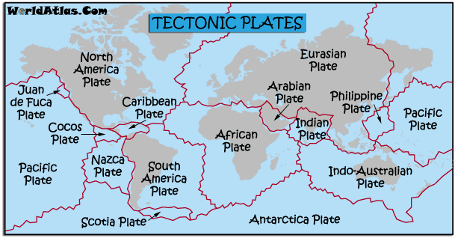
Plate Tectonics
Abbey Naji

Slide 2
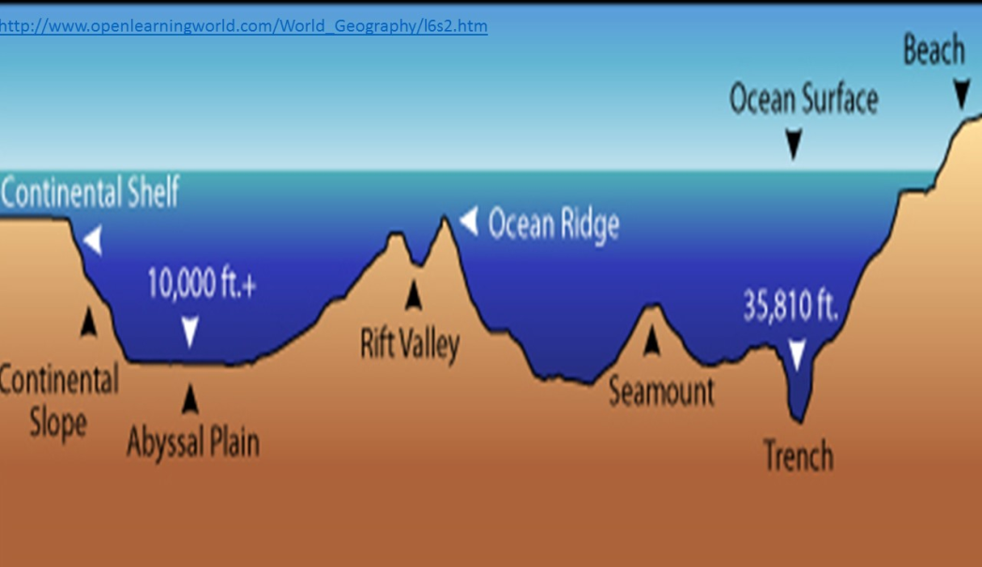
Oceanic and Continental Crust
Oceanic Crust
Continental Crust
The thin part of Earth’s crust that underlies the ocean’s basin
The relatively thick part of Earth’s crust that forms the large landmasses
The difference between the 2 is oceanic crust denser than continental crust.

Slide 3
Lithosphere And Asthenosphere
Lithosphere: The rigid outer part of earth
Asthenosphere: The upper layer of Earth’s mantle, below the lithosphere.
The difference between the Lithosphere and the Asthenosphere is the Lithosphere is made up of the crust of the upper part of the mantle . While the asthenosphere is on upper mantle material.

Slide 4
Convergent and Divergent
Convergent Boundary
Divergent Boundary
Plates coming closer together.
Plates moving in the opposite direction.
The difference between Convergent Boundary and Divergent Boundary is when 2 plates are pushing away from each other they are Divergent, but when they are pushing together are Convergent.

Slide 5
Folding and Faulting
Folding
When the crust is bent upward or downward
Faulting
When the crust is broken.
The difference between folding and faulting is faulting occurs when the crust is broken. Folding occurs when the crust is bent upwards and downwards

Slide 6
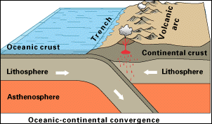
Oceanic Crust / Oceanic Lithosphere
Oceanic Lithosphere: Consists mainly of mafic crust.
Oceanic Crust: The thin part of Earth’s crust, outlines the oceans basin.
The difference between oceanic crust and the oceanic lithosphere is the oceanic crust is found on the ocean floor and the oceanic lithosphere is deeper into Earth.

Slide 7
Normal and Reverse Fault
Normal
Faults that move away from each other.
Reverse
Faults that move away from each other,
The difference between the normal fault and the reverse fault is that the normal fault moves away from each other while the reverse fault collides with each other.

Slide 8
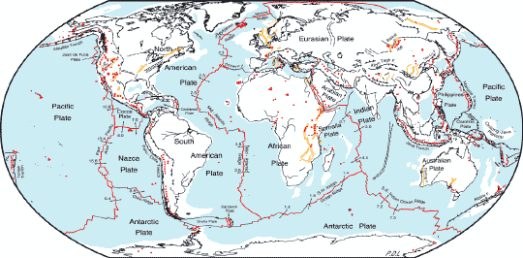
Additional Facts About Tectonic Plates
A Famous boundary is the San Andreas fault in California.
Scientists can track movement of tectonic plates.
The Mariana Trench is the deepest part of the ocean.

Slide 9
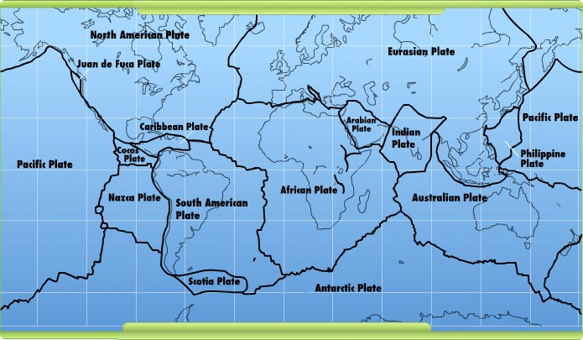
Summary
In a short summary, tectonic plates is what shaped earth today from Pangaea. Without all these types of plates, who knows what Earth would look like now.

Slide 10
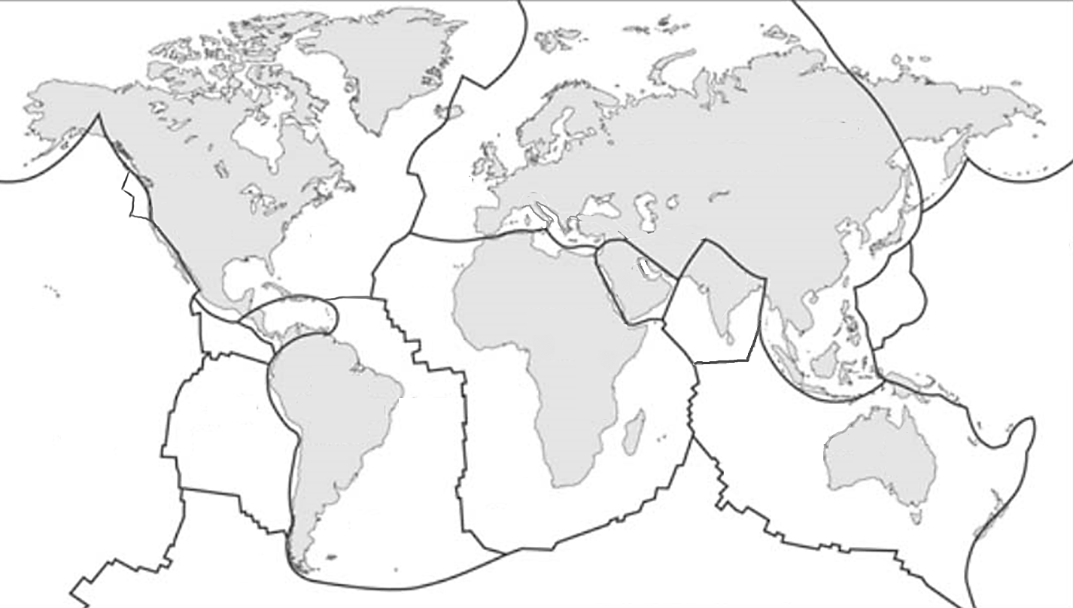
Cites
Google
Google Images
Ducksters.com (Earth Science For Kids.)

