Slide 1
How do we help MORE kids to be academically successful?

Slide 2
Meeting the Challenge

Slide 3
AVID Program
Advancement Via Individual Determination
[L. avidus]: eager for knowledge

Slide 4
The Mission of AVID
The mission of AVID is to ensure that ALL students, and most especially students who are in the middle:
will succeed in rigorous curriculum,
will complete a rigorous college preparatory path,
will enter mainstream activities of the school,
will increase their enrollment in four-year colleges, and will become educated and responsible participants and leaders in a democratic society.
AVID’s systemic approach is designed to support students and educators as they increase school wide and district wide learning and performance.

Slide 5
What AVID IS:
An in-school academic support program that prepares students for college eligibility and success
A collaboration between Equity and High Potential
For all students, but it targets those in the academic middle
Implemented school- and district-wide
About providing access to higher education
What AVID IS NOT:
A remedial program
A free ride
A school within a school
A quick fix
An affirmative action program

Slide 6
AVID at STOUT
4 AVID classes at STOUT
Grades 7 and 8
About 25-30 students per class
An elective class

Slide 7
A Sample Week in AVID
The AVID elective is a one-period academic elective that takes place during the regular school day.
Monday | Tuesday | Wednesday | Thursday | Friday
AVID Curriculum | Tutorial Groups with College Tutors | AVID Curriculum | Tutorial Groups with College Tutors | Field Trips College Visits Speakers Motivational Activities Service Learning Binder Evaluations
AVID Curriculum includes:
Writing Curriculum
College and Careers
Study Skills
AVID Tutorials include:
Study Groups
Writing Groups
Socratic Seminars

Slide 8
Rigorous Classes
In addition to the AVID elective class, each AVID student will be placed in an accelerated math or enriched language arts class.
Placement will be dependent on the student’s strength in each subject area.

Slide 9
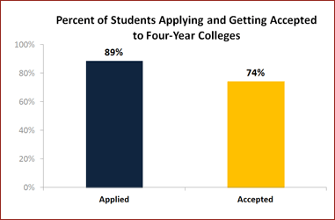
Percent of Students Applying & Getting Accepted to 4-Year Colleges
One of the most impressive and consistent indicators of AVID's success is the rate at which it sends students to four-year colleges. 74% of 2011 AVID graduates were accepted to a four-year college. Another 18% attended 2-year colleges.
OVERALL, 92% of AVID students attend college.

Slide 10
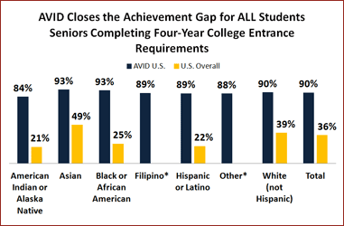
AVID Closes the Achievement Gap for ALL students

Slide 11
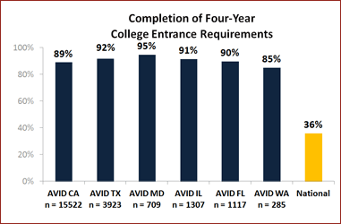
Completion of Four-Year College Entrance Requirements
AVID students complete university entrance requirements at a much higher rate than their non-AVID peers.

Slide 12
The AVID Student Profile
Students with Academic Potential
Average to High Test Scores
GPA in the academic middle
College Potential with Support
Desire and Determination

Slide 13
Why should they start thinking about college NOW? It’s only 6th-grade!
Because, they will learn good habits, like
how to study,
how to read well,
how to write clearly, and
how to problem solve with others
These will help in high school and make it possible for them to go to college later!

Slide 14
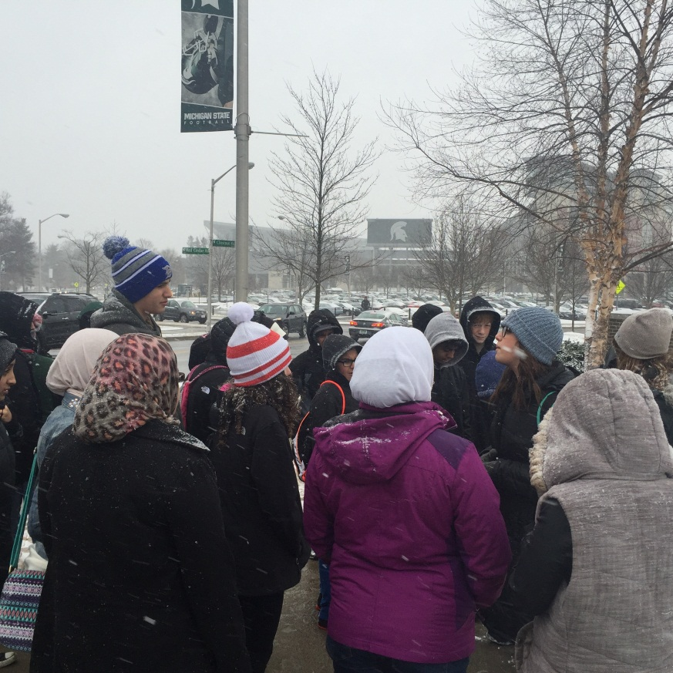
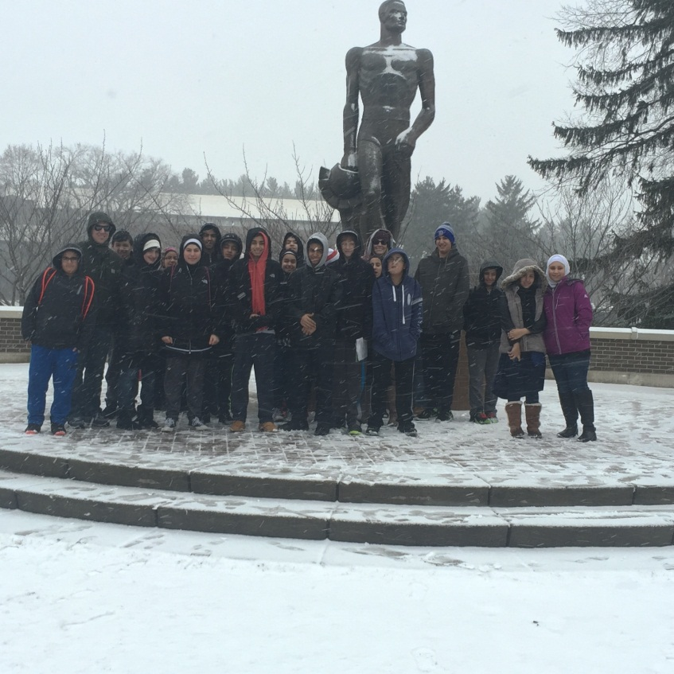
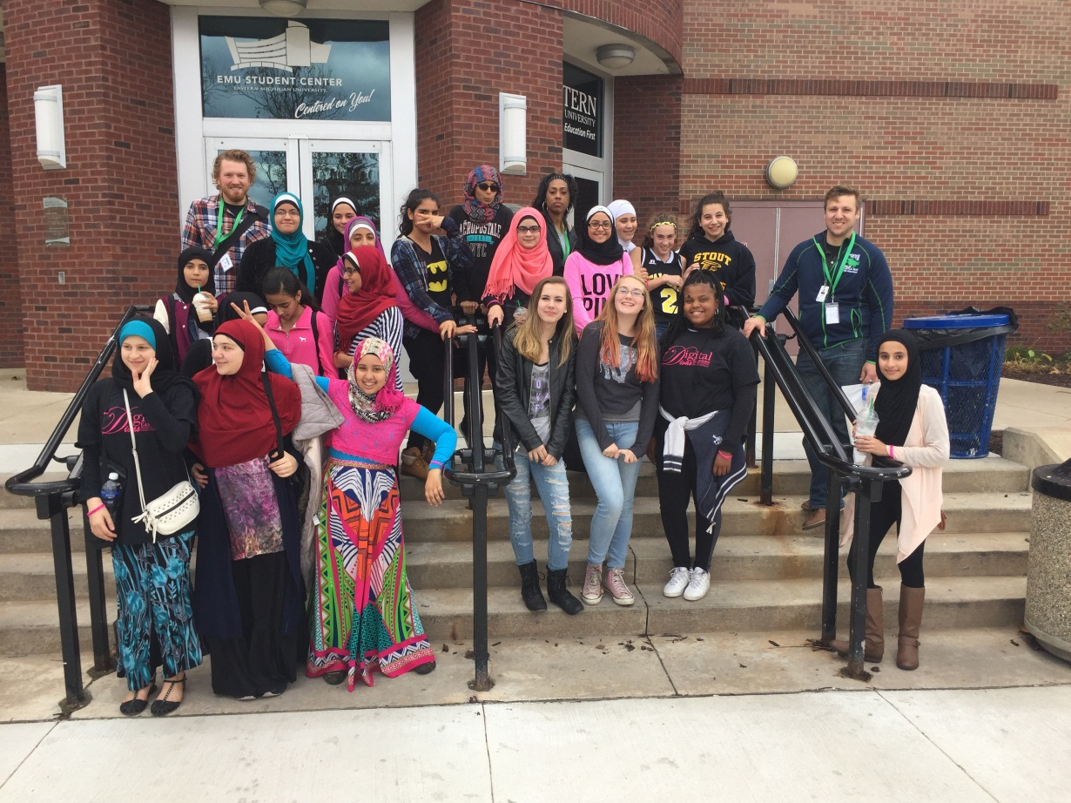
FIELD TRIPS!!!!!!!!!!!!

