Slide 1
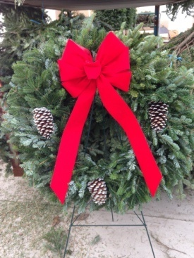
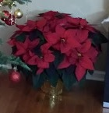
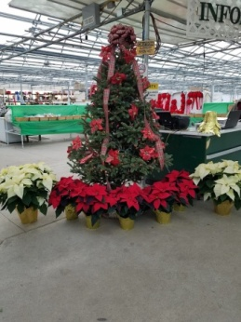
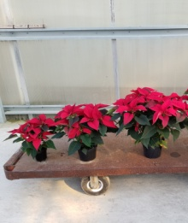
Poinsettia & Wreath Fundraiser STEM Middle School
Schwartz’s Greenhouse is once again offering their traditional holiday poinsettia and wreath fundraiser. We have all of the favorite
Colors, Red and White!
The Deadline for all orders this year will be Friday, November 13. Orders will be delivered to O.L. Smith Middle School on Monday, November 23.
Flowers Price:
Mini (1 Plant, 3-5 blooms) $6
Single (1 Plant, 5-7 Blooms) $10
Double (2 Plants, 8-14 Blooms) $18
Large (3 Plants, 12-20 Blooms)
Note: All prices include Gold Pot Cover.
*Remember plants are temperature sensitive keep them warm.
Fresh Door Wreaths add the finishing touch to your holiday décor. We offer handmade Frasier Fir wreaths in a variety of sizes. Frasier Fir is on of the longest lasting evergreens, giving you indoor or outdoor options.
Plain Wreaths Finished Size Price:
12” Wreath 18”-20” $20
16” Wreath 25”-27” $25
Decorated Wreaths Finished Size Price:
12” Wreath 18”-20” $30
16” Wreath 25”-27” $35
We are looking forward to working with you to make this a joyous holiday season for all. Please call or text Amy Fradkin at 313-598-3553 with any questions.
Sincerely,
The Schwartz Family & STEM MIDDLE school

