Slide 1
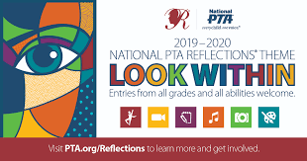


Why Participate in Reflections?

Slide 2

The Mission of PTA is to make every child’s Potential a reality
Founded in 1969, National PTA Reflections encourages all students in
prekindergarten through grade 12
to explore the arts for fun and recognition.

Slide 3
Art Education is critical to a Child’s development and success
Underserved students show the greatest relative improvements when participating in arts programs like Reflections.
Through movement, social interactions, emotional expression and application of skill, arts education provides an academic advantage to students.
The arts provide safe learning environments where students take risks, explore ideas, express their individuality and support their peers in a positive way.
Studies also find that students are more engaged, and teachers are more effective in arts-rich schools.
Research shows that students who study the arts develop a sense of personal responsibility toward their communities and can positively affect the community social life through their artwork.
PTA Our children Magazine

Slide 4
Emotional Development.
Through creative art, children may be able to represent experiences that they cannot verbalize. They may draw pictures out of proportion, exaggerating things that are important to them. When we value children's creativity, we help them feel valued as people, raising their self-esteem.
Cooperative Extension August 13 2015

Slide 5
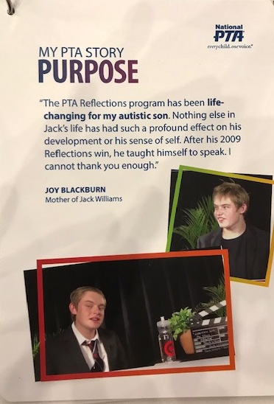
Meet Jack Williams
In 2012, PTA Reflections added the “Special Artist” Category to better meet the needs of artists like Jack

Slide 6
Better Academic Outcomes
A report by Americans for the Arts states that young people who participate regularly in the arts (three hours a day on three days each week through one full year) are four times more likely to be recognized for academic achievement, to participate in a math and science fair, or to win an award for writing an essay or poem than children who do not participate

Slide 7
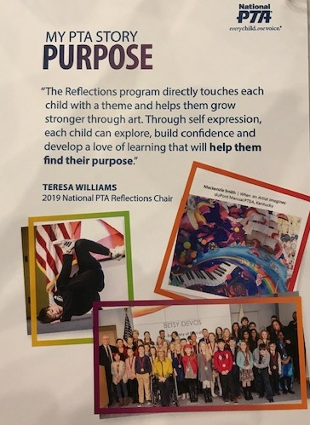
Helps them Find their Purpose

Slide 8
What can Reflections do for PTA
Increase awareness of what PTA does
Increase PTA exposure to more families
Increase membership
Allow for collaboration with the community
Help meet our mission goals

Slide 9
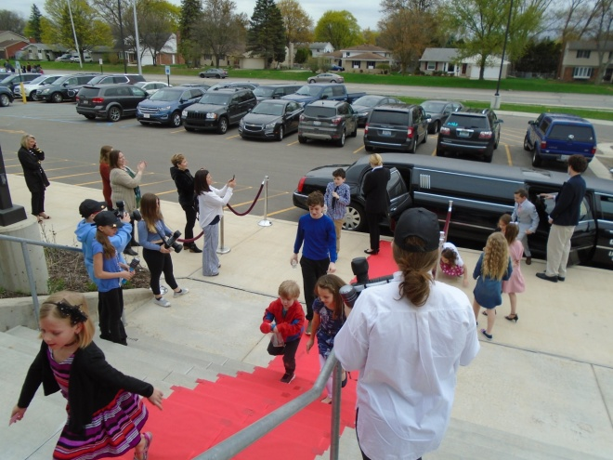
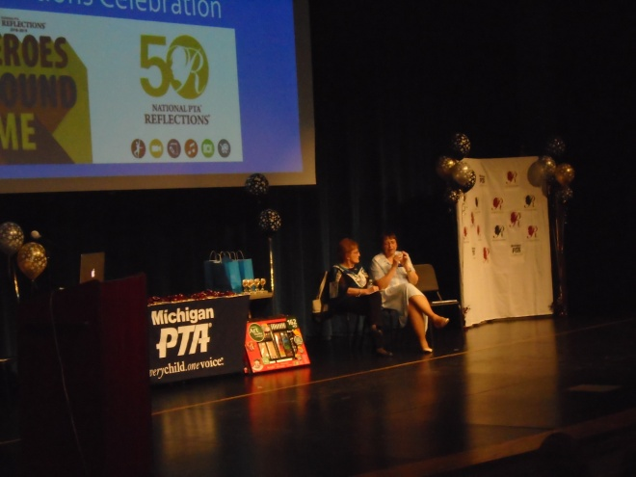
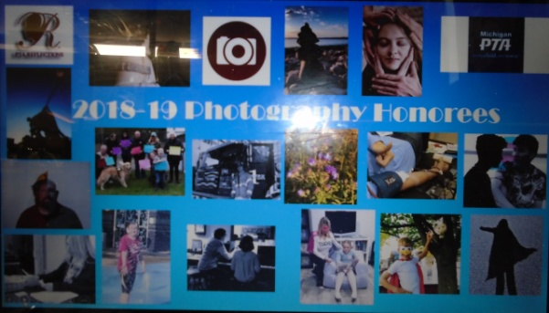

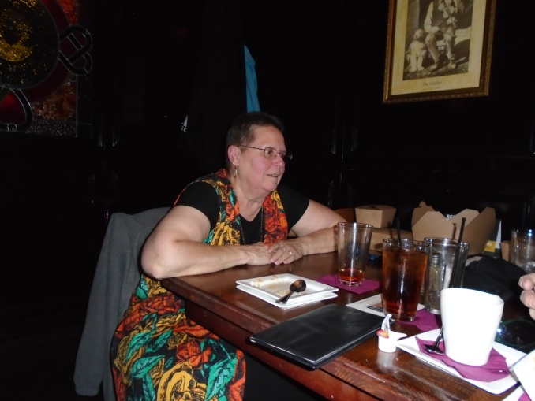
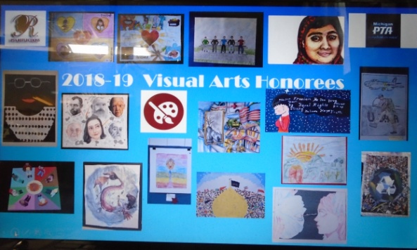
It’s Fun!

Slide 10
About the Cultural Arts (from The Cultural Arts & the PTA brochure)
By: Mary Lou Anderson
The cultural arts are happiness. Happiness is drawing, dancing, finger painting. Happiness is modeling with clay, making music or a poem, performing in a play.
The cultural arts are discovery. Art, music, literature are airlifts to the life experiences and life ways of other people, other races, other cultures, other times. They lead to understanding oneself and others.
The cultural arts are wisdom. They are mankind’s commentary on the human condition-its comedy and tragedy. They are insights into the anguish and ecstasy, the conflicts and triumphs, the failures and aspirations of humanity.
The cultural arts are breathing room and growing space. Creative activities air feelings, frustrations, tensions. They nurture growth and self-realization. They are healthful and healing.
The cultural arts are sense-expanding, mind-expanding, spirit-expanding. They amplify and intensify the capacity to see, hear, feel, think, understand, and communicate.
The cultural arts are power-moral and social. They awaken man’s conscience. They move men to compassion, to social action and justice.

Slide 11

Courtesy of National PTA

