Slide 1
Alpena, Michigan Thursday, May 28 and Friday, May 29, 2020

Slide 6
Also Included:
Fossil dig with Paleo Joe
Building Underwater Rovs and testing them.
Shipwreck Cruise
One night at Thunder Bay Resort
Adventure Park in Mackinac City
Fort Michilimackinac
Elk Ride
Bonfire with S’mores
✪ 1 breakfast
2 lunches
2 dinners

Slide 7
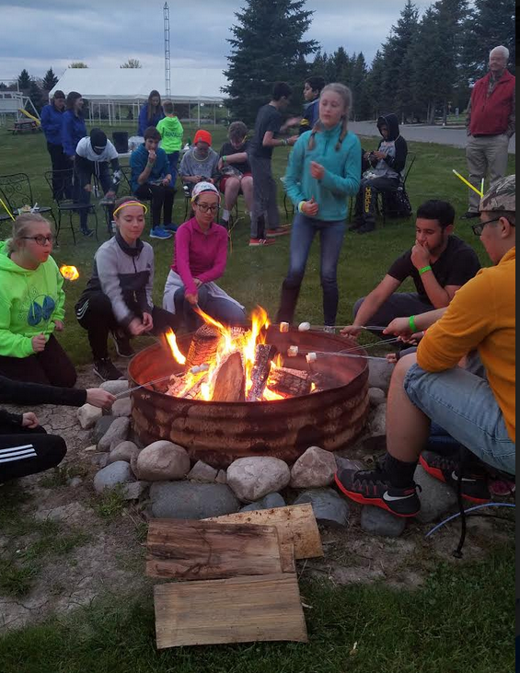
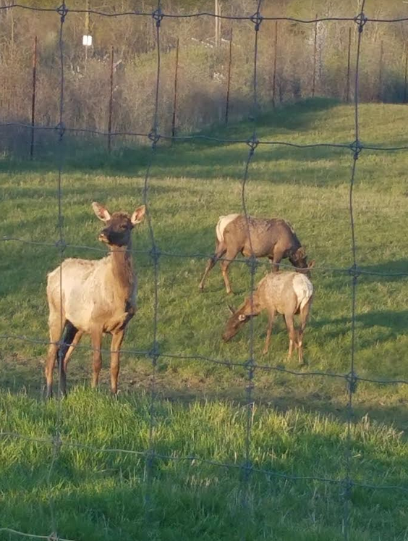
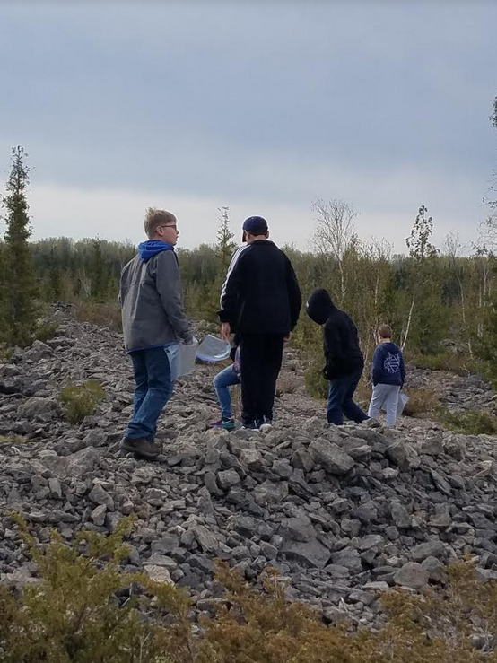
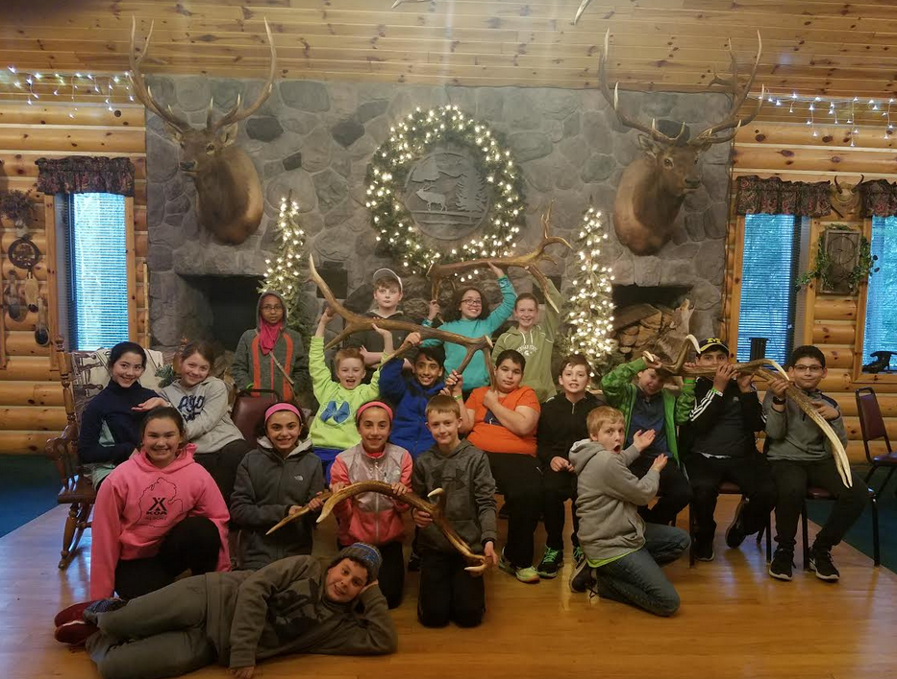

Slide 8
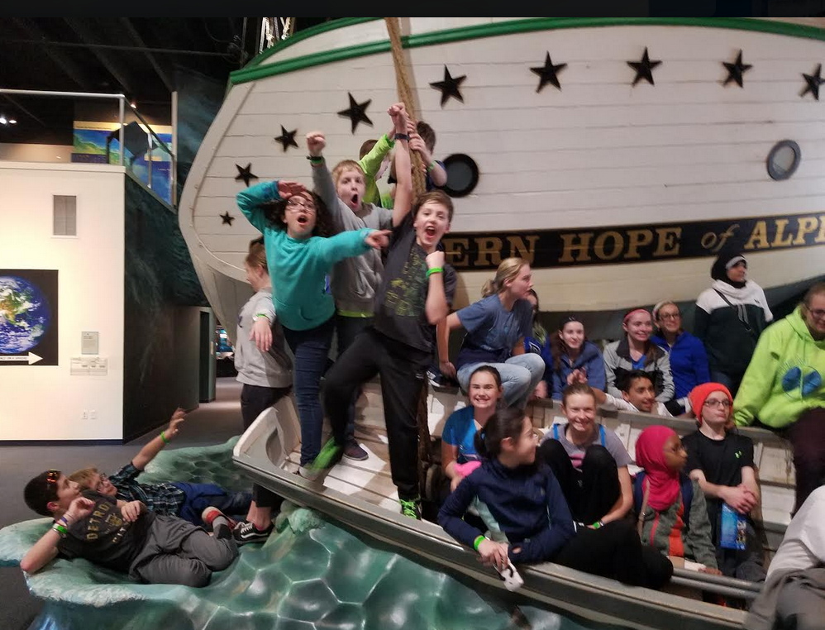
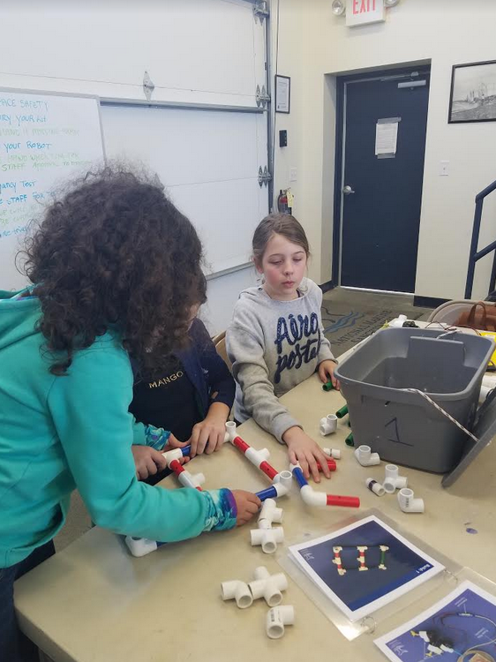
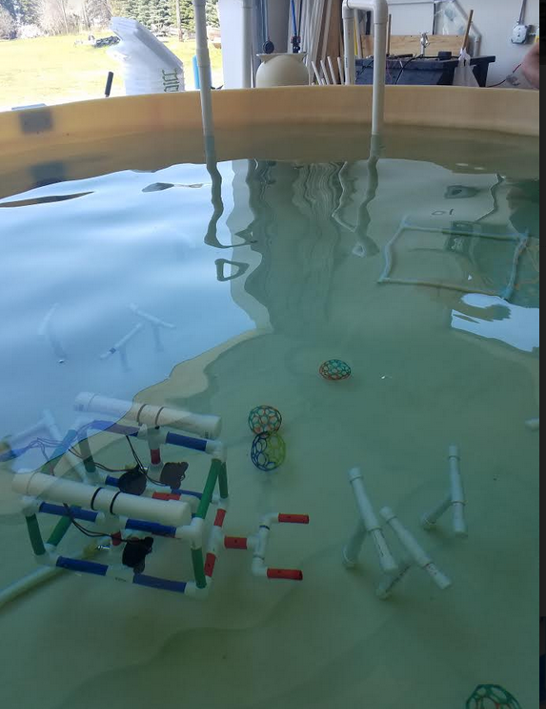
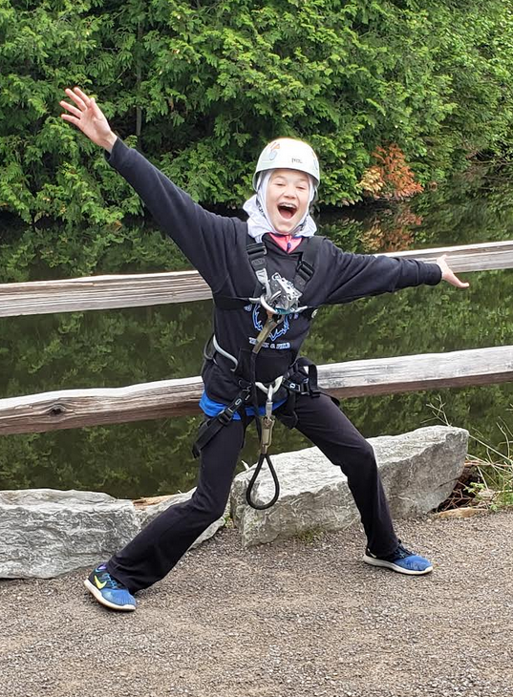

Slide 9
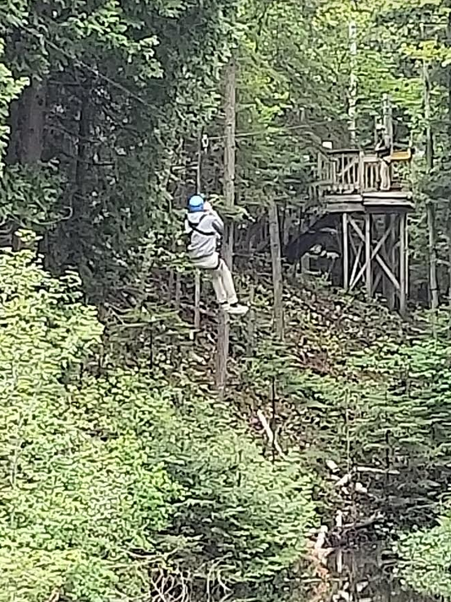

Slide 10
Total price is $445.00 / student $465.00 / adult

Slide 11
