Slide 1
3rd & 4th Grade M-Step
What areas will my child be tested?
When will my child take it?
What can my child expect when taking this test?
How can I help my child?

Slide 2
Beginning in April, we will administer the M-STEP to students in Grades 3-5. Like last year, the M-STEP will be given online to nearly all students and will measure current student knowledge of Michigan’s high academic standards in English Language Arts (ELA), mathematics, science, and social studies.
We want your child’s state assessment experience to be as relaxed and stress-free as possible. We are asking that you make sure your child has a good breakfast and enough sleep during this testing period and to remind them to do their best at all times.
Remember, testing is a part of learning. State assessment results do not impact student grades. They are designed to provide information on student knowledge and ability in relation to state grade-level content standards that identify what educators and employers believe students need to know and be able to do to be career- and college-ready upon graduation. Schools and district use the results for curriculum planning and school improvement initiatives that benefit all students.
The M-STEP web page at www.michigan.gov/mstep includes more helpful information for families. There, you will find Student Testing: What Parents Can Do to Help Prepare; and Michigan’s Education Assessment System, What it is, What it Means and What it Offers
الاهالي الكرام،
ابتداءً من الاسبوع الثاني من شهر أبريل/ نيسان وحتى نهاية شهر مايو/ أيار ، تقدم جميع مدارس الولاية على اختبار طلاب صفوف ٣-٥ الابتدائي في مواد اللغة والقراءة، الرياضيات، العلوم والاجتماعيات. هذا الاختبار المسمى ب " ام ستب" يقيس مدى مهارة الطالب وخبرته في هذه المواد بمقارنته بالمستوى المحدد من الولاية.
نود منكم تنبيه وتشجيع أولادكم على بذل أفضل مجهود والتركيز على ما يفعلونه خلال الامتحان. ننصح جميع الطلاب بالنوم المبكر والحصول على ١٠ ساعات من النوم والراحة. كما نود منكم أن تحرصوا على تناولهم لوجبة الإفطار قبل بداية الدوام المدرسي.
الرجاء مراجعة الجدول المرفق بأيام اختبار الطلاب وتجنب عمل اية مواعيد للدكتور او خلافه.
إذا لديكم أية أسئلة ،لا تترددوا في الاتصال بالمدرسة والحصول على استفساراتكم.
مع جزيل الشكر والتقدير،
السيد ابوالروس
مدير المدرسة

Slide 3
4th Grade M-Step
English Language Arts
Math

Slide 4
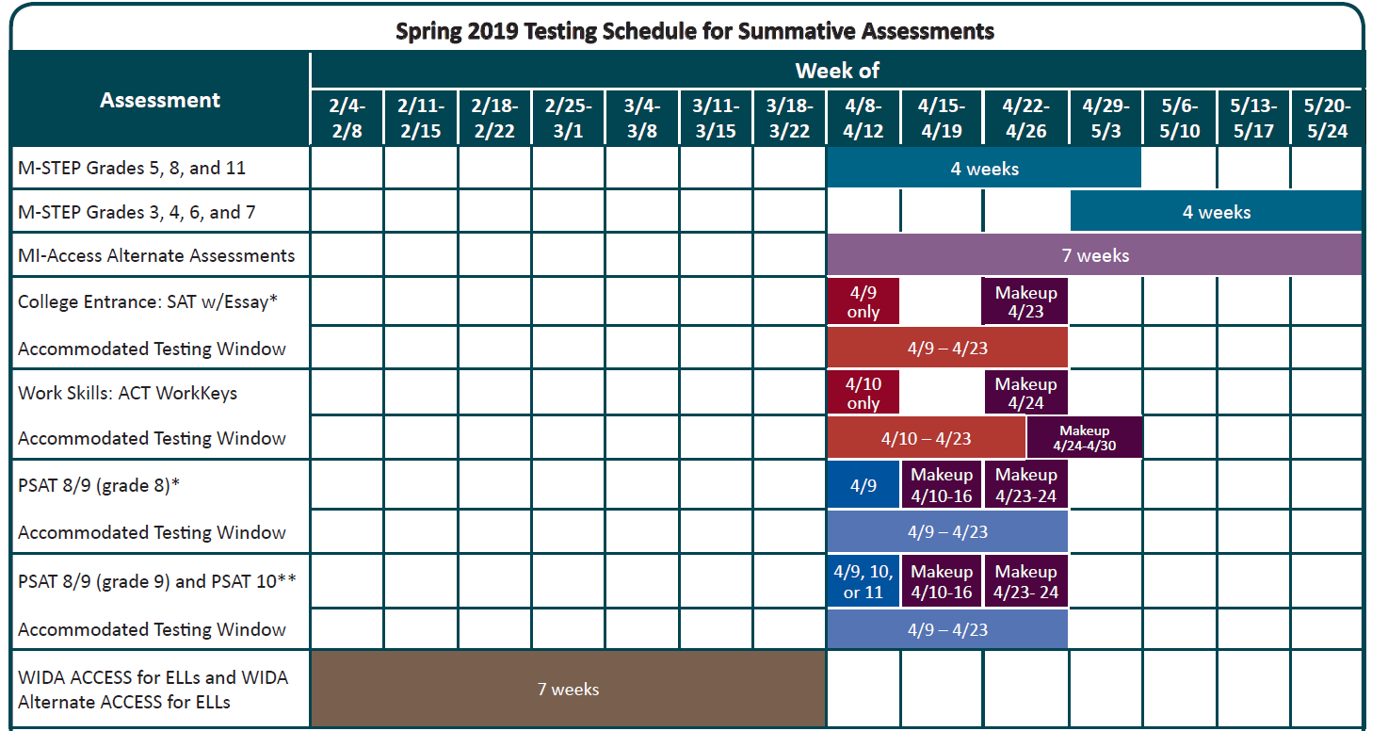
Notes:
We will be starting next week. We will take the 1st week off for Ramadan and then continue. Detailed Schedule to come

Slide 5
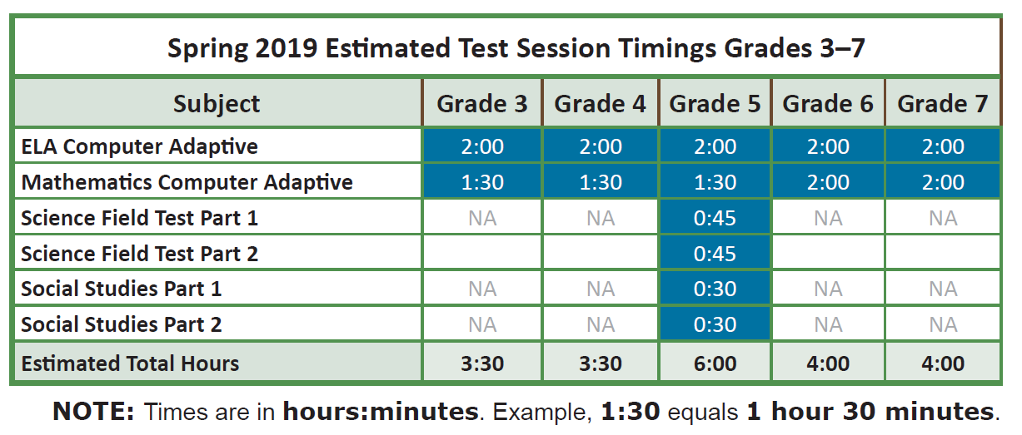
Estimated Time of Testing
Notes:
No time limit-these are estimated time

Slide 6
2019 M-Step Testing Schedule (April 29 - May23)
3rd and 4th Grade Math CAT
 | 4/29 Monday | 4/30 Tuesday | 5/1 Wednesday | 5/2 Thursday | 5/3 Friday
9:00- 11:30 | Math | Math | Math | Makeups | Makeups
No Testing during the week of May 6th/ First week of Ramadan
3rd and 4th Grade ELA CAT
 | 5/13 Monday | 5/14 Tuesday | 5/15 Wednesday Late Start | 5/16 Thursday | Friday
9:00 - 11:30 | ELA | ELA | ELA | Makeups | Makeups
Notes:
Test next week Monday the 29th which is Math. We will NOT test the first week of Ramadan. We will take a break and continue the following week which is May 13th

Slide 7
Student Practice
1. Mini-Module Videos
Can watch through eDirect
https://assets.drcedirect.com/States/MI/Tutorials/Student/20170113/index.html
2. Online Training Tests
OTTs only work on Chrome Web Browser
https://wbte.drcedirect.com/MI/portals/mi/

Slide 8
ELA Sample Passage-based Writing Prompts
https://www.michigan.gov/mde/0,4615,7-140-22709_70117-455340--,00.html
ELA Sample Passage-based Writing (PBW) Prompts and Student Essay Scores
https://www.michigan.gov/mde/0,4615,7-140-22709_70117-456071--,00.html

Slide 9
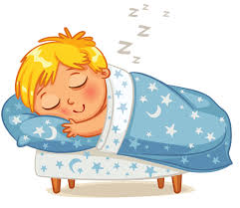
How can I help my child?
Allow your child to practice
Talk about the importance of the test
Get rest by going to bed on time
Make sure your child eats a healthy breakfast
Remain positive and calm

Slide 10
What can I do as a student?
I will attempt all the questions and will not leave any blank
I will do my best and take my time
I will get enough rest the night before
I will eat a healthy breakfast
I will reread and double check my answers
I will REMAIN POSITIVE
I KNOW I WILL DO MY BEST !

