Slide 1
Save The
Oceans
By:The Ecology club

Slide 2
What We’re Doing and Why We Are Doing This?
The Ecology Club is supporting the removal of trash from the oceans through the work of the 4 Oceans company. By purchasing this bracelet made of 100% recycled items, you will remove of 1 pound of trash from the ocean and coastlines. What can you do to help?

Slide 3
What is our Goal?
Our goal is to raise 100 dollars per class. Can you help us do it? You can become an activist for the environment. Every 10 refundable cans or bottles you return to the store makes 1 dollar that can be donated towards this cause. That will help us reach our goal.

Slide 4
How Do You Get a Bracelet?
Every 20 dollars raised will get your class a bracelet. The bracelet is made of 100% recycled materials and is adjustable and waterproof.(For both boys and girls.)

Slide 5
Why Should You Help Us?
You should help us because
You can help remove pollution.
You can make the world a better place.
You can help the underwater animals.

Slide 6
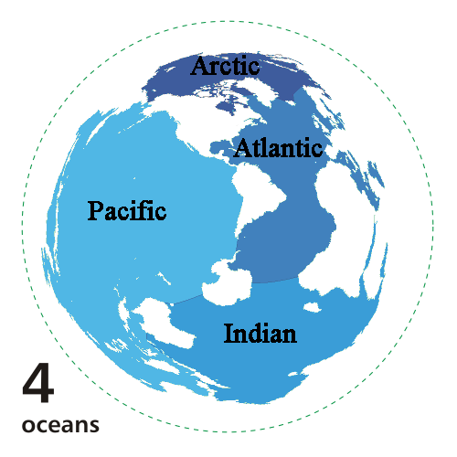
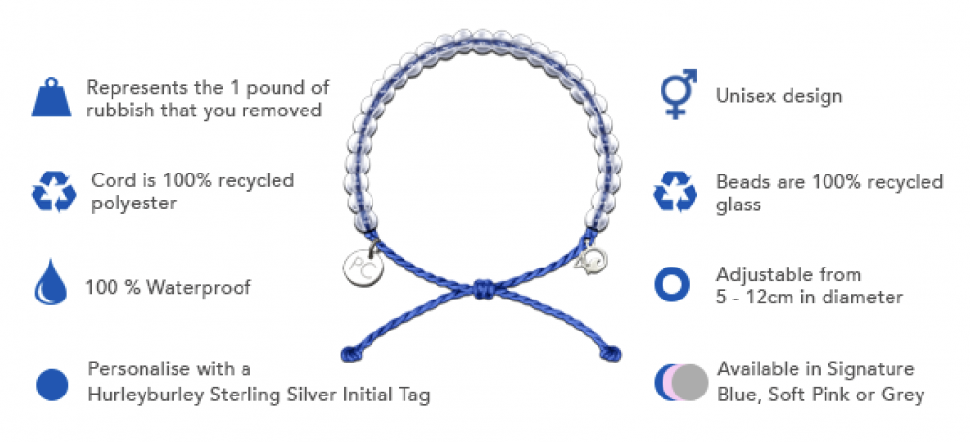
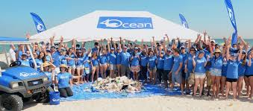
Thank You for your Support!

Slide 7
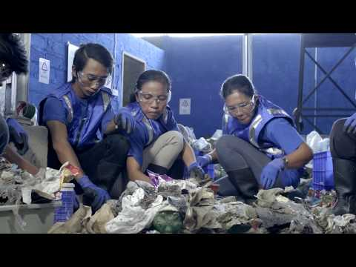
https://4ocean.com/

