Slide 1
Oakman Elementary First Grade Presents:
Seven Steps to Being the Best State Superintendent for Michigan!

Slide 2
Step 1: Be honest and courteous.

Slide 3
Step 2: Respect yourself and others.

Slide 4
Step 3: Be Responsible.

Slide 5
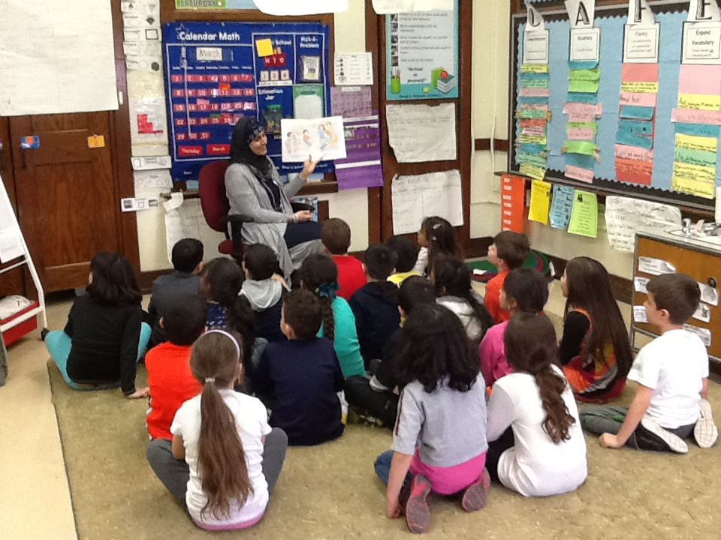
Step 4: Have integrity and make the right choices

Slide 6
Step 5: Value Diversity

Slide 7
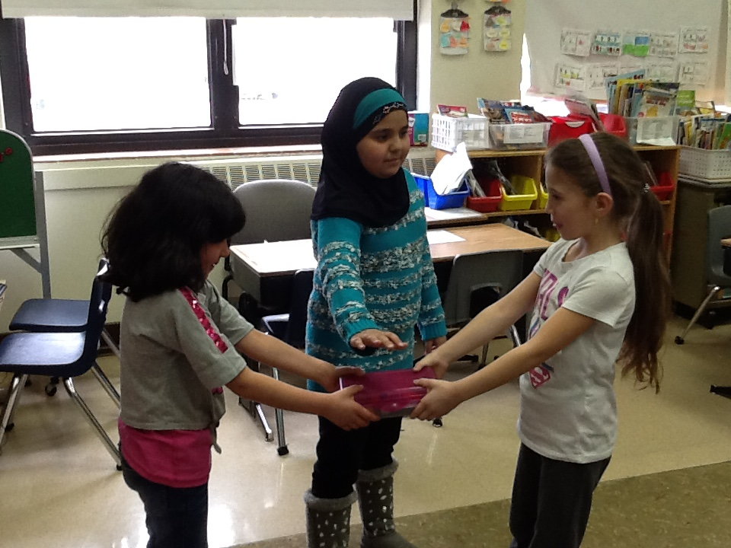
Step 6: Be a peacemaker

Slide 8
Step 7: But most of all…just keep being you! Congratulations Mr. Whiston!

