Slide 1
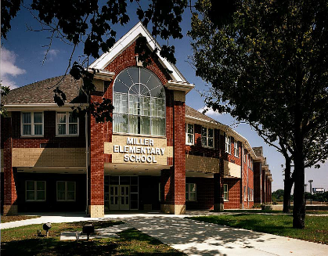
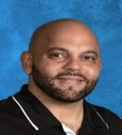
Our Vision – Students First – Inspire, Educate, Celebrate
Miller Elementary
School News
January 2019 – A Beautiful Year Ahead!
Principal: Radewin Awada
January 2019
January Important Dates
18th – Half Day School Dismissed 11:45 a.m.
18th – PTA Meeting 9 a.m. Miller Cafeteria
21st – NO SCHOOL Martin Luther King Birthday
22nd – Half Day School Dismissed 11:45 a.m.
22nd End of Second Card Marking
23rd – 25th Mobile Dentist
14th – Feb 1st – NWEA Testing Window
A Message from Mr. Awada
Happy 2019 to all, may all be blessed with a year of continued health, happiness and prosperity. Thank you, Miller Community for your continued support as we’ve made it half way toward our fundraising goal of raising $10,000 for the Children of Yemen. NWEA Testing began Monday and will continue for the rest of the month of January. Help Miller students be the best they can be by discussing the test, asking students to take their time, read the questions carefully before answering and believe in themselves. Ensure they are going to bed early and eating a healthy breakfast. Students practicing reading and math skills daily ensures they will continue being successful. Spend quality time with students by reading, practicing math games and completing homework daily. Visit the teacher BLOGS for useful resources, daily homework and valuable resources students may use at home.
School Website/Teacher Blogs
Keep up with district, school and classroom activities by visiting your child’s teacher Blog at:
miller.dearbornschools.org
Student Safety
All doors remain locked throughout the day, visitors entering Miller need to use the main doors. All visitors are required to check in the Office and obtain a Visitor Pass. All parents signing students out are to report to the Office. In order to preserve critical instructional time parents needing to consult with a teacher must first call and make an appointment. Please be advised if someone is seen in the school hallway without a Visitor Pass, they will be considered a stranger and the police will be called.
Proper Attire
Per district policy, students will be going outdoors until temperatures reach 20 degrees Fahrenheit. When wind chill temperatures are below 20 degrees Fahrenheit students will not be having outdoor recess. Ensure child is dressed appropriately with a winter coat, gloves, waterproof shoes and a hat being worn daily. Students need to be responsible and account for their clothing, if a clothing item is lost please check the lost and found in the Cafeteria. Lost and Found will be emptied monthly with contents being donated to the Salvation Army.
Daily Schedule
Breakfast is served from 8:00 –8:25 a.m., first bell rings at 8:32 a.m. and instruction begins at 8:35 a.m. Children entering school after 8:45 a.m. are considered late and are required to be signed-in at the main office by a parent. Dismissal is at 3:35 p.m., (Half-day dismissal is at 11:45 am), kindergarten through 2nd grade students are to be picked up from the classroom. Students must leave school promptly at 3:35 dismissal as supervision ends at 3:50 pm. For the remainder of the year ALL students are to be dropped off at the front doors, parents DO NOT follow students into the school.

Slide 2
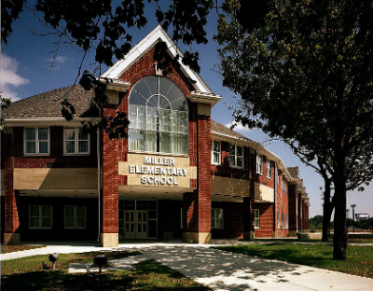
Our Vision – Students First – Inspire, Educate, Celebrate
Miller Elementary
Policy and Procedures
Welcome 2019
Principal: Radewin Awada
January 2019
Attendance /Absence Policy
Consistent and timely attendance to school is critical and enhances your child’s educational experience and vastly improves their chances of success. Excessive absence may be referred to the court system. Avoid removing students from the classroom during the school day. Avoid making doctor and dental appointments during the school day.
If your child is unable to attend school, please contact the school office at: (313) 827 – 6851 before 9:00 am. When calling, parents should give the following information: student and teacher name, grade, reason for and length of absence.
When the student returns to school, it is his or her responsibility to check with teachers for missed work. If a student will be absent for more than two days, please contact the teacher to make arrangements for homework to be picked up from the office. Homework will be ready for pick up the following school day by 3p.m. Weekly lesson plans and daily homework are posted on the teacher blog.
Visitors & Class Interruptions
Our goal is to limit class interruptions as much as possible so that students are not distracted from their academic learning. Therefore, all visitors must check-in to the office upon entering the school. NO Exceptions!
Late-arrival
Parents/guardians are required to sign students in the school office. Students will not be allowed a pass to enter class without a parent signature.
Lunch Schedule
Kindergarten 11 – 11:38 a.m.
1st 11:20 – 11:58 a.m.
2nd 11:40 – 12:18 p.m.
3rd 12 – 12:38 p.m.
4th 12:20 – 12:58 p.m.
5th 12:40 – 1:18 p.m.
Illness & Medication
Students should stay at home if they are vomiting, fever over 99 degrees, strep throat, pink eye and any type of rash (may not be in school without consent from a doctor). Parents must notify the school office if their child has any preexisting conditions such as allergies, diabetes, or asthma, ensuring proper precautions are taken. No child is to carry any prescription or over the counter medication in school, no exceptions. The office staff will administer any medication when a "Medication Authorization Form" is signed in the main office.
Lost & Found
When a child has lost an article of clothing or school item, check the Lost & Found located in the cafeteria. Any items not claimed will be donated to the Salvation Army.
Celebrations and Snacks
Classroom snacks are limited to fruits or vegetables . Each teacher has her/his own preference for celebrating student birthdays and holidays. NO CUPCAKES or food is allowed in the classrooms.
Early-release
The office will not call students down early to wait for parents to arrive. When it becomes necessary for your child to leave the school due to illness or injury, a parent will be called. If a parent cannot be reached, a person designated on the child’s emergency card will be contacted. the person picking up the student must report to the office to sign the student out. There is no student check-out after 3:00 p.m.
Remind: Send short code text in body of message @8276850 to the number 81010. You’ll receive a welcome text from Remind.
Important Phone Numbers
Attendance# (313) 827-6500
Office # (313) 827-6501
Fax # (313) 827 - 6505
Office:
Attendance: 313 827-6851
Fax: 313 827 - 6855

Slide 3
Miller PTA News
PTA cordially invites all parent to the January 18th , 2019 PTA Meeting / Open House beginning at 9 AM in the Miller Cafeteria, please invite a neighbor and a friend. Open House is a great opportunity for parents to experience the great teaching and learning taking place in the classroom.
PTA members contribute a great deal to the successes of our school and would benefit greatly from additional volunteers to help with organizing events for our children. Consider becoming an active member of the Miller PTA, working together we will provide an excellent education Miller students require to be successful today, tomorrow and in life. Contact PTA President Mr. Althalaya at (248) 819 - 1200 for more information on how you may become an active member and contribute to your child's success. We really need parent volunteers to help during the Book Fair this week between 9 - 11 a.m. and 1 – 3 p.m..
Miller PTA, Staff and Students are teaming up for the remainder of the year to raise $10,000 for the “Children of Yemen”, thank you to all who have contributed thus far. Monthly updates and a graph will be used to monitor our progress. Miller Staff welcome volunteers in the classroom. Time spent in your child’s classroom during the school day is priceless, the effects profound and memories resonate for years to come. Be a difference maker and volunteer in the classroom and school. We look forward to having you! Thank You PTA moms and dads for making Miller the special school it is, your continued efforts make a world of difference. Looking forward to a wonderful 2019 where together we continue forging a stronger community one child at a time. Happy New Year to all as we begin anew during 2019!
Sincerely,
Miller PTA

