Slide 1
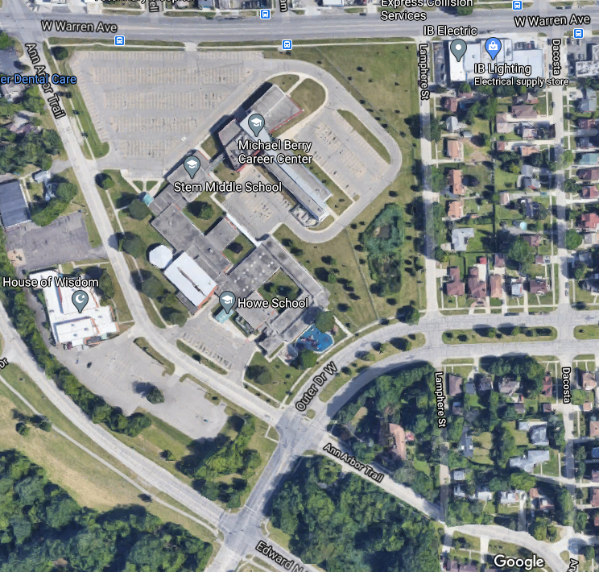
The Dearborn Heights Campus
Dr. Winifred L. Green
Principal and CTE Director
Dearborn Public Schools
Dearborn Heights Campus
225863 Ann Arbor Trail
Dearborn Heights, Michigan 48127
(313) 827-4800
greenw@dearbornschools.org

Slide 2
High School Programs at DHC
Dearborn Center for Math Science and Technology (DCMST)
Michael Berry Career Center
Dearborn Magnet High School
High School PAES Program (Special Education)

Slide 3
Other Programs at DHC
(not part of tonight’s presentation)
Adult and Community Education
STEM Middle School
Howe Montessori Elementary
Howe Special Education Programs

